Slide 1
Warm-up
Cindy and Monica were best friends turned enemies but no one knows why. You hear from Jose that Monica is mad at Cindy because she’s dating her crush. However, you talk to Monica and she says she is mad because Cindy talks behind her back not because of a boy. Who do you believe? Why? (3-5 sentences)

Slide 2
Vocabulary
Primary Sources – actual records that have survived from the past
Secondary Sources – accounts of the past created by people writing about events sometime after they happened

Slide 3
Why Use Primary Sources?
Studying primary sources helps you form reasoned conclusions, base your conclusions on evidence, and connect documents to their your context of meaning.
Be careful, they can contain BIAS!
What are examples of bias?

Slide 4
Why Use Secondary Sources?
We use these sources because they are convenient references.
They are based on research from multiple primary sources (they do the work for you!)
What are some problems with only using secondary sources?

Slide 5
Primary vs. Secondary
I am about to show you slides of different sources.
Use the index cards provided to let me know if you think the source is primary or secondary.
A for Primary
B for Secondary

Slide 6
Textbook

Slide 7
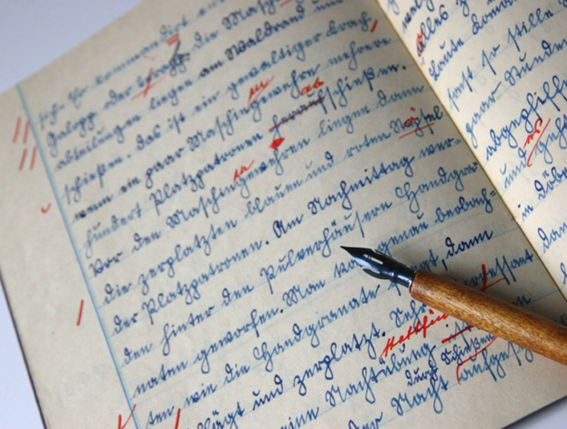
Sam Houston’s journal

Slide 8
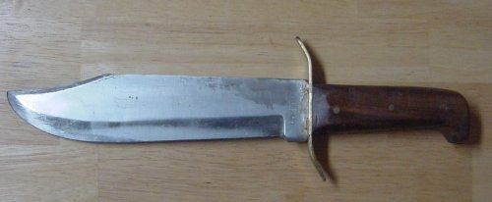
Jim Bowie’s knife

Slide 9
Video of Obama speaking to a crowd

Slide 10
A copy of a John F. Kennedy’s Speech in your Textbook

Slide 11
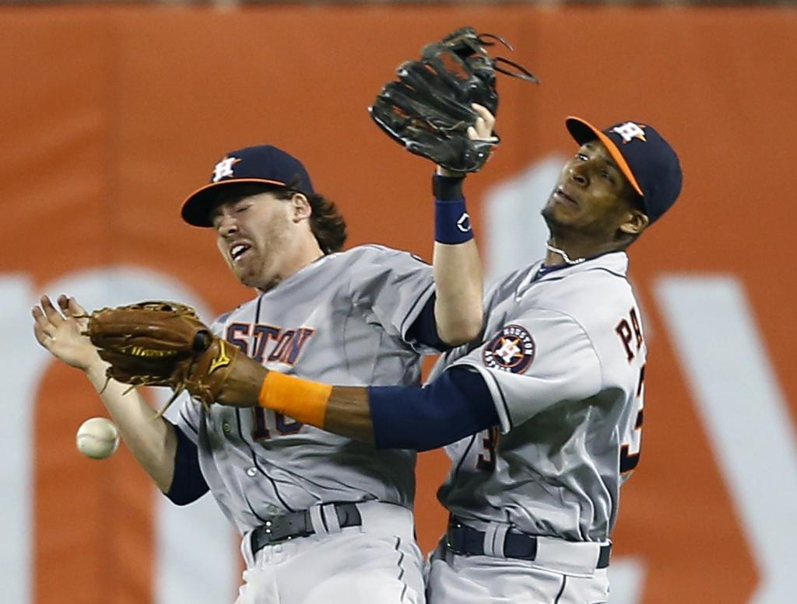
Newspaper article about the Astros game

Slide 12
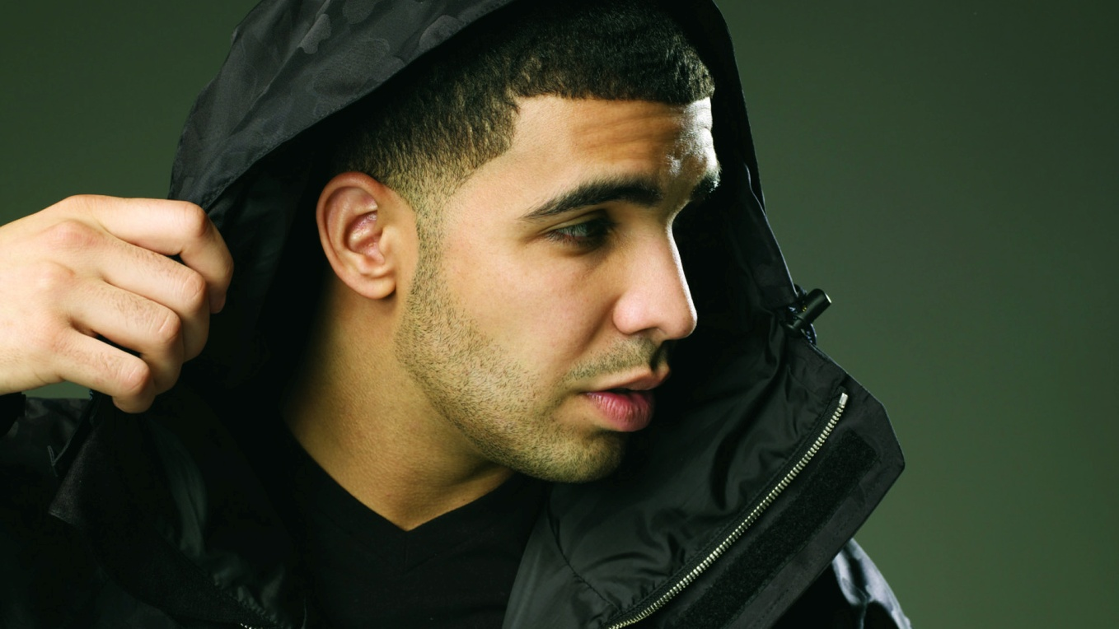
A Drake song

Slide 13
A painting of World War II

Slide 14
My autobiography

Slide 15
A biography about Ms. Brame

Slide 16
A poem about the Texas Revolution

Slide 17
If using the internet:
.gov – usually the most reliable
.edu – associated with an educational institution and have high reliability
.org – associated with education and/or non-profit organizations and are generally reliable
.com – established for commercial purposes, tend to be bias in documents choices

