Slide 1
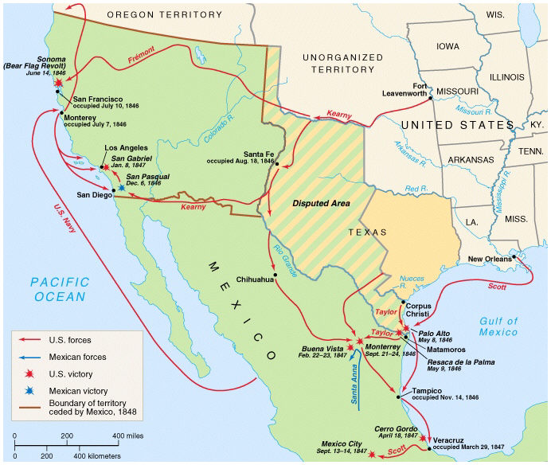
Warm-Up:
How would you best describe the idea behind Westward Expansion?
Based on the map, what can you infer about the causes of the Mexican-American War and the results of the Mexican American War?

Slide 2
Treaty of Guadalupe Hidalgo, 1848
The United States obtains the Mexican Cession from Mexico.
Areas include California, Nevada, Utah, New Mexico, and parts of Arizona, Colorado, Kansas, and Wyoming
Mexico recognizes the Rio Grande as the southern boundary of the United States.
The United States pays Mexico $15 million for the land
The United States assumes $3.25 million in debts owed to American citizens by the Mexican government.

Slide 3
