Slide 1
Warm-Up:
If you were at a concert and had to save seats for a few friends, how would you do it?

Slide 2
Unit 4: Spanish & Anglos Settle Texas
Spanish Missions

Slide 3
Review
Native Americans alone in Texas
Spanish Explorers come to Texas
Spanish don’t find much gold and lose interest
French come
Spanish come back and build missions to “save” land

Slide 4
Vocabulary
Settlement = a small community
Mission = a religious settlement
Presidio = a Spanish military outpost
Friar = member of a Catholic religious order

Slide 5
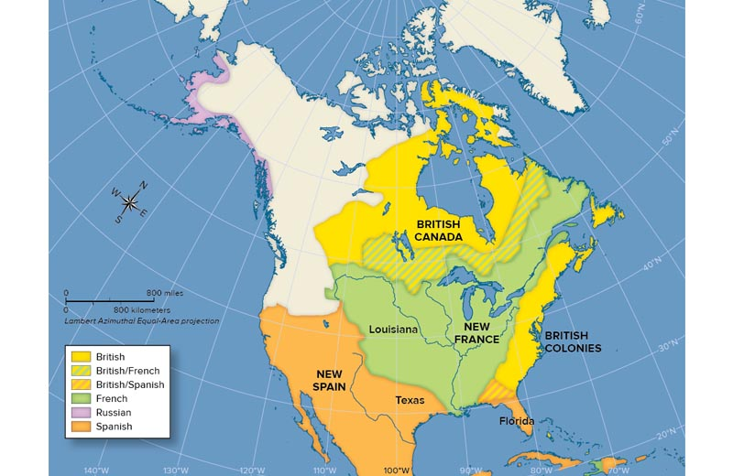
European Claims in North America

Slide 6
Spanish Missions
Purpose:
  Claim land for Spain
  Convert Native Americans to Christianity
First Mission:
  Corpus Christi de la Ysleta - 1682
Most Famous Mission:
  San Antonio de Valero - 1718 (the Alamo)
Abandoned Missions:
  French no longer threat so Spain abandons missions in 1773

Slide 7
Spanish Presidios
Purpose:
  Protect Missions from French and Native American attacks
Mission
Mission
Presidio
Mission
Mission

Slide 8
Spanish Settlements
San Antonio becomes the first official settlement in Texas.
Later it becomes the first capital of Texas under Spanish rule.
Started because soldiers wanted to bring their families with them.

Slide 9
Life in Spanish Texas
Friars | Soldiers | Natives
Convert Natives | Protect from Native and French Attacks | Learned Spanish and about Catholicism
Pray, Eat, Relax, and Study | Find Natives that have left the mission | Farming, cooking, cleaning
Supervise the Natives work | Get supplies to the mission | Building the mission
Teach Natives Spanish |  | Learning Spanish crafts

Slide 10
Corpus Christi de la Yselta (1682)
Notes:
Friars founded the first permanent settlement of Europeans in Texas

Slide 11
San Francisco de los Tejas (1690)
Father Damián Massanet
Notes:
First Spanish mission in East Texas, failed due to drought and disease. Home of the Tejas who rejected Catholicism and resented the Spanish

Slide 12
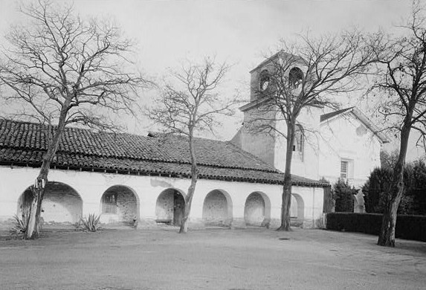
Mission San Juan Bautista (1699)
Father Francisco Hidalgo
Notes:
Five miles from the Rio Grande, strategically located near a series of crossings providing access to Texas… Here the outpost eventually grew into a complex of three missions, a presidio, and a town. Nicknamed the “Mother of Texas Missions” because it was the base for many expeditions whose aims were to establish missions in East Texas. The mission provided grain, cattle, and horses to the missionaries on those expeditions.

Slide 13
Concepción Mission in San Antonio (1718)
Notes:
San Antonio was founded after Spanish officials saw the need for a settlement midway between New Spain and the new missions. The 500-mile journey from the Rio Grande to East Texas was dangerous. Supplies arrived slowly, if at all. At times, the people of East Texas had no choice but to trade with the French in Louisiana or starve. San Antonio was ideal because of the San Antonio River.

Slide 14
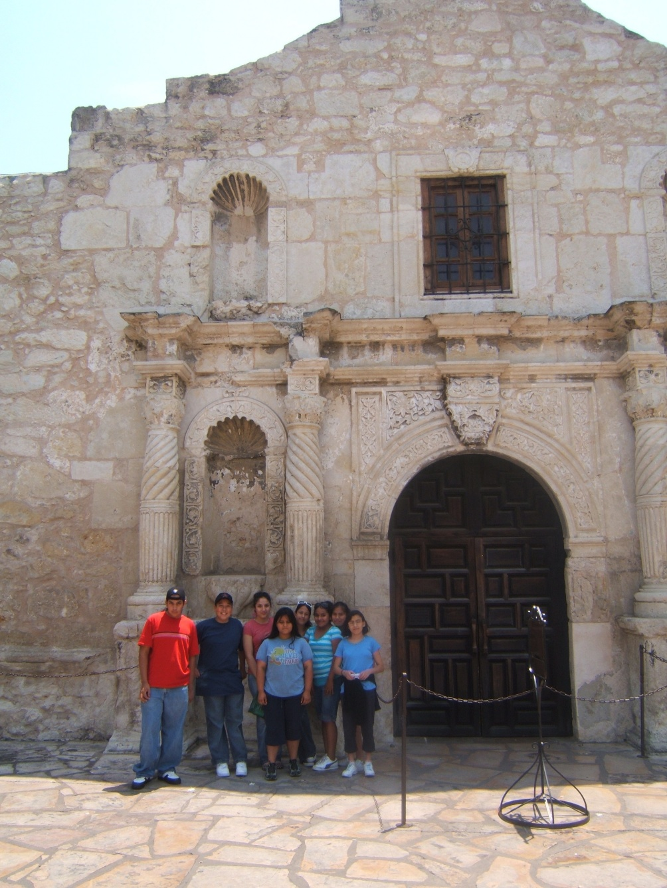
San Antonio de Valero (1718)
The Alamo

Slide 15
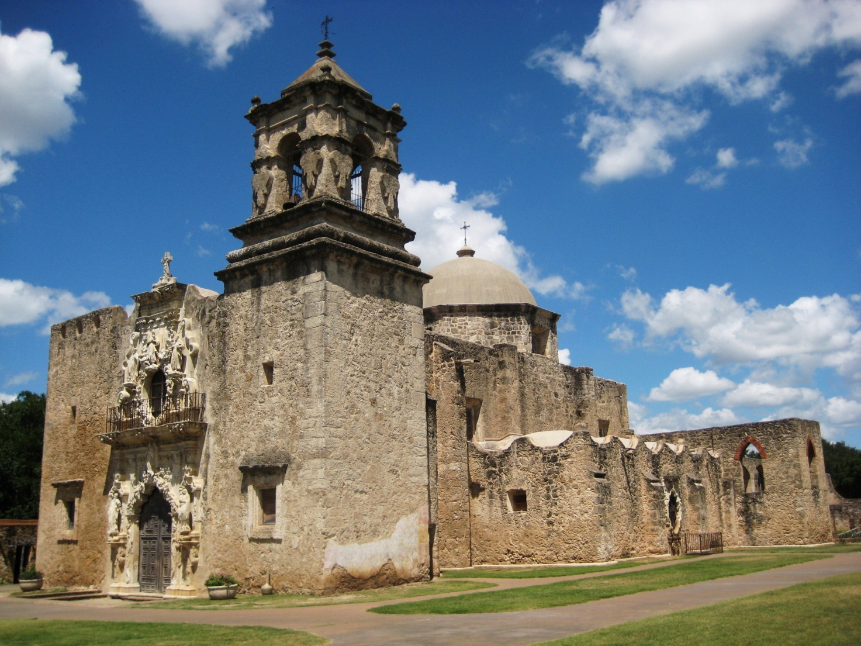
Mission San José (1720)
Father Antonio Margil de Jesús
Notes:
Another San Antonio mission, arguably the most successful Texas mission

Slide 16
La Bahía/Goliad Mission (1722 & 1749)
Originally built where Fort St. Louis was but later moved to Goliad

Slide 17
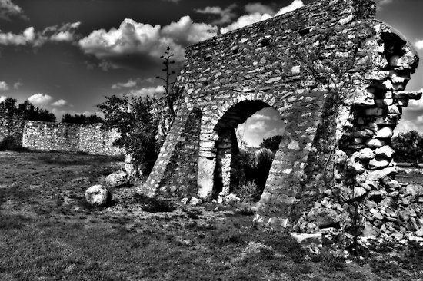
Mission Santa Cruz de San Sába (1757)
Notes:
Apaches and Comanches roamed the area, but Spanish missionaries wanted an opportunity to convert the Apaches into Christians. The Apaches had, in fact, asked for the mission, hoping to use the Spaniards as protection from their fierce Comanche enemies. Apaches visited the mission from time to time to receive food and gifts but never stayed very long. The Comanche attacked the mission, and Texas missions failed to Christianize the Plains people. The Apaches and Comanches were too fiercely independent to give up their nomadic lifestyle. Efforts moved elsewhere.

