Slide 1
Snapshot #1 Review
Snapshot will be September 24 (Red) and September 25 (Purple)!

Slide 2
Give three examples of PRIMARY sources.

Slide 3
Primary Sources
Letters
Journals
Speeches
Interviews
Autobiographies
Government documents
Photographs
Artifacts
Data
Art (from the time period)
Articles (from the time period)
Books (from the time period)
Maps (from the time period)
Propaganda (from the time period)

Slide 4
Give three examples of SECONDARY sources.

Slide 5
Secondary Sources
Encyclopedias
Biographies
Most published books (unless written at the time of the event)
Textbooks
Internet sites
Edited works

Slide 6
What would be an accurate summary for this primary source?
Letter from William Barrett Travis (Commander of the Alamo), February 24, 1836
“I am besieged by a thousand or more of the Mexicans under Santa Anna. I have sustained a continual Bombardment & cannonade for 24 hours & have not lost a man. The enemy has demanded a surrender at discretion, otherwise, the garrison are to be put to the sword, if the fort is taken. I have answered the demand with a cannon shot, & our flag still waves proudly from the walls. I shall never surrender or retreat. Then, I call on you in the name of Liberty, of patriotism & everything dear to the American character, to come to our aid with all dispatch. The enemy is receiving reinforcements daily & will no doubt increase to three or four thousand in four or five days. If this call is neglected, I am determined to sustain myself as long as possible & die like a soldier who never forgets what is due to his own honor & that of his country. Victory or Death.”

Slide 7
Summary
Open-ended

Slide 8
What is William Travis’ point of view regarding the siege of the Alamo in this quote?
Letter from William Barrett Travis (Commander of the Alamo), February 24, 1836
“I am besieged by a thousand or more of the Mexicans under Santa Anna. I have sustained a continual Bombardment & cannonade for 24 hours & have not lost a man. The enemy has demanded a surrender at discretion, otherwise, the garrison are to be put to the sword, if the fort is taken. I have answered the demand with a cannon shot, & our flag still waves proudly from the walls. I shall never surrender or retreat. Then, I call on you in the name of Liberty, of patriotism & everything dear to the American character, to come to our aid with all dispatch. The enemy is receiving reinforcements daily & will no doubt increase to three or four thousand in four or five days. If this call is neglected, I am determined to sustain myself as long as possible & die like a soldier who never forgets what is due to his own honor & that of his country. Victory or Death.”

Slide 9
Point of View
Open-ended

Slide 10
What would be a valid conclusion based on evidence from the reading?
Alonso Álvarez de Pineda was a skilled cartographer from Spain who gained map-making experience during the 1500s. He bravely led several expeditions to map the western coastlines of the Gulf of Mexico, from the Yucatán Peninsula to the Panuco River, just north of Veracruz. During his expeditions, he disproved the idea of a sea passage to Asia, and established the boundaries of the Gulf of Mexico. This included the coastlines of Florida, Alabama, Mississippi, Louisiana, and Texas. His map is the first known document of Texas history!

Slide 11
Evidence-Based Conclusion
Open-ended

Slide 12
What word choice shows bias within this excerpt?
Alonso Álvarez de Pineda was a skilled cartographer from Spain who gained map-making experience during the 1500s. He bravely led several expeditions to map the western coastlines of the Gulf of Mexico, from the Yucatán Peninsula to the Panuco River, just north of Veracruz. During his expeditions, he disproved the idea of a sea passage to Asia, and established the boundaries of the Gulf of Mexico. This included the coastlines of Florida, Alabama, Mississippi, Louisiana, and Texas. His map is the first known document of Texas history!

Slide 13
Determining Bias
Skilled
Bravely
Watch for opinion words!

Slide 14
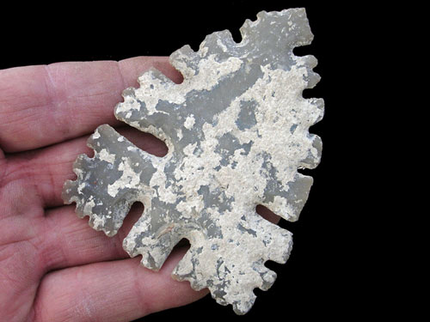
What might an archaeologist conclude by analyzing the artifact in the image?
Found in Texas; before 1500

Slide 15
Artifact
The arrowhead suggests that the first Texans (Native Americans) used bows and arrows as an important tool for hunting.

Slide 16
Categorize possible causes of exploration using ESP.
Desire to spread religion
Desire to build an empire
Desire to find gold

Slide 17
E = Economic; S = Social; P = Political
E = Desire to find gold
S = Desire to spread religion
P = Desire to build an empire

Slide 18
What is the purpose of this poem?
In the Nacreous Hours by Larry D. Thomas
before the Great Storm of 1900, a calm breeze rustles palm fronds like cotton castanets. The evening sky is opalescent, disturbed by nothing
but the glides, swoops, and dives of gulls. The children are nonchalant, licking their bright red lollipops, stuffing their mouths with sticky
pink wads of cotton candy. The waves, grown mysteriously angry, strike shell beds with the opening notes of Beethoven's Fifth. The puppet limbs
of lovers are thrashing in the sky, the cotton threads of their lifelines twisting, fraying, held by but the screaming of the brute, careening gulls.

Slide 19
Purpose
Open-ended

Slide 20
Which of the following sources is most likely to contain bias?
A Wikipedia page on Rick Perry
The biography of John Green in the back of The Fault in Our Stars
A Spanish explorers account of a fight between his men and natives
A photo of the president’s family in front of the White House

Slide 21
Identifying Bias
A Spanish explorers account of a fight between his men and natives

Slide 22
What would be a valid conclusion for this political cartoon?

Slide 23
Conclusion
Open-ended

Slide 24
What do you believe is the artist/author’s point of view in this cartoon?

Slide 25
Point of View
Open-ended

Slide 26
Give two examples of cultural diffusion.

Slide 27
Cultural Diffusion
Food
Language
Traditions
Religion
Clothing

Slide 28
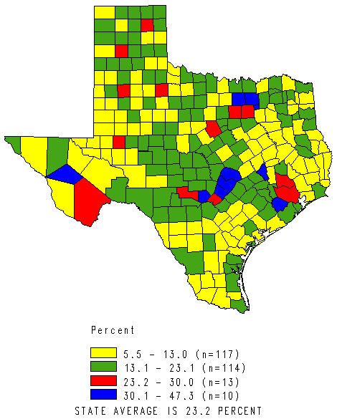
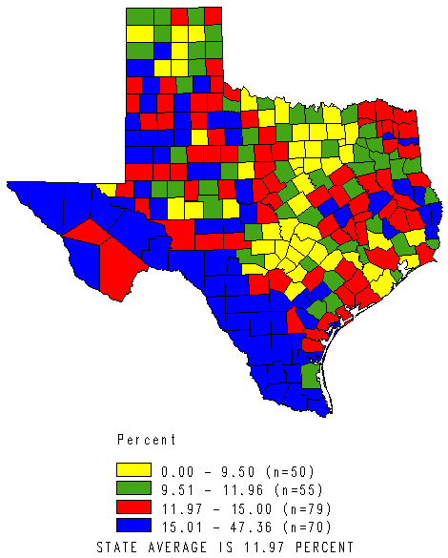
Based on the maps, what is the relationship between education and poverty?
Percent College Education or Higher in Counties in the State of Texas, 2000
Percent Families in Poverty in Counties in the State of Texas, 1999

Slide 29
Education and Poverty
In general, people with lower levels of education are more likely to find themselves in poverty.

Slide 30
What is a person’s Point of View?

Slide 31
POV
The mental position from which things are viewed. It is based on environmental and cultural influences and creates ones’ opinions.
Ex: Sam Houston’s opinion on secession

Slide 32
What is Frame of Reference?

Slide 33
Frame of Reference
Thinking that is based on your prior knowledge and experiences.
Ex: Knowing about the Civil War can alter your understanding of race relations in the South.

Slide 34
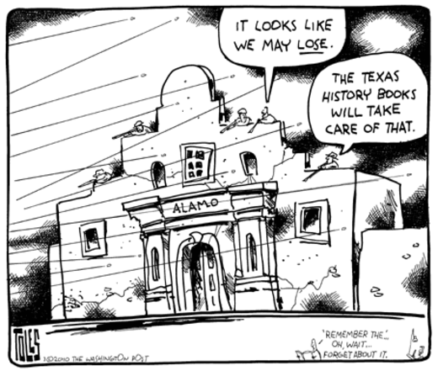
What conclusion can one draw about the author’s point of view in this political cartoon?

Slide 35
Point of View
Open-ended

