Slide 1
Reconstruction
In Texas, 1865-1870

Slide 2
War is Over! But…
Since the Confederacy lost the war, much of the South was destroyed, and money was hard to come by.
African Americans were free, but many were without food or shelter.
Tensions and differences between many Northerners and Southerners continued after the war.

Slide 3
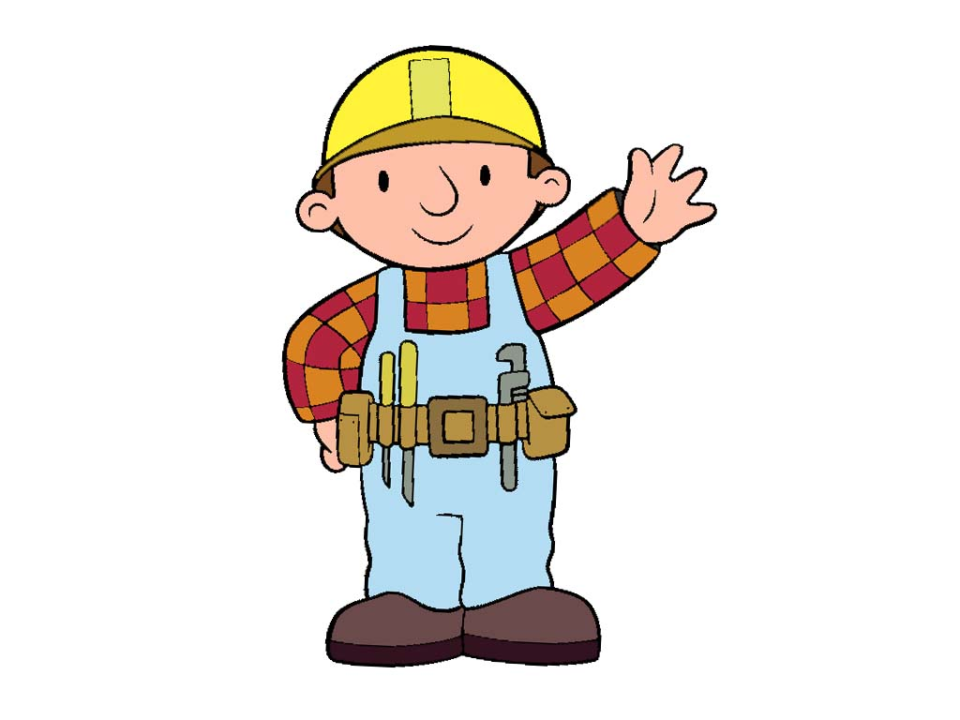
What WAs reconstruction?
Reconstruction was a period of rebuilding in which the Southern states were gradually brought back into the Union.

Slide 4
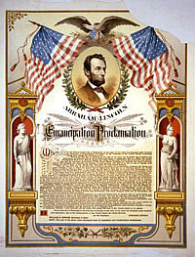
Juneteenth - 1865
Because of distance and the war, many African Americans did not immediately learn about the Emancipation Proclamation of 1863.
The news finally reached Galveston, Texas on June 19th, 1865. Juneteenth became a celebration for the freedom of enslaved Texans.

Slide 5
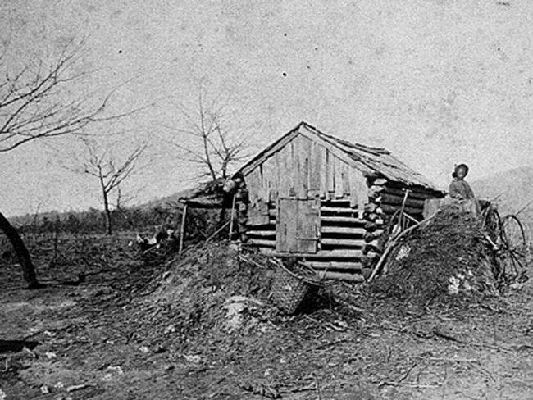
FREE AT LAST???
Since most slaves were uneducated and their only skill was farming, they often stayed in the South and worked on plantations.
Poor whites and freed slaves would rent a small plot of land from plantation owners and a large percentage of their crops were sold for profit by the landowners. Poor whites and freed slaves were left with little to sell and feed their own families.
This was called sharecropping, which was not much better than slavery.

Slide 6
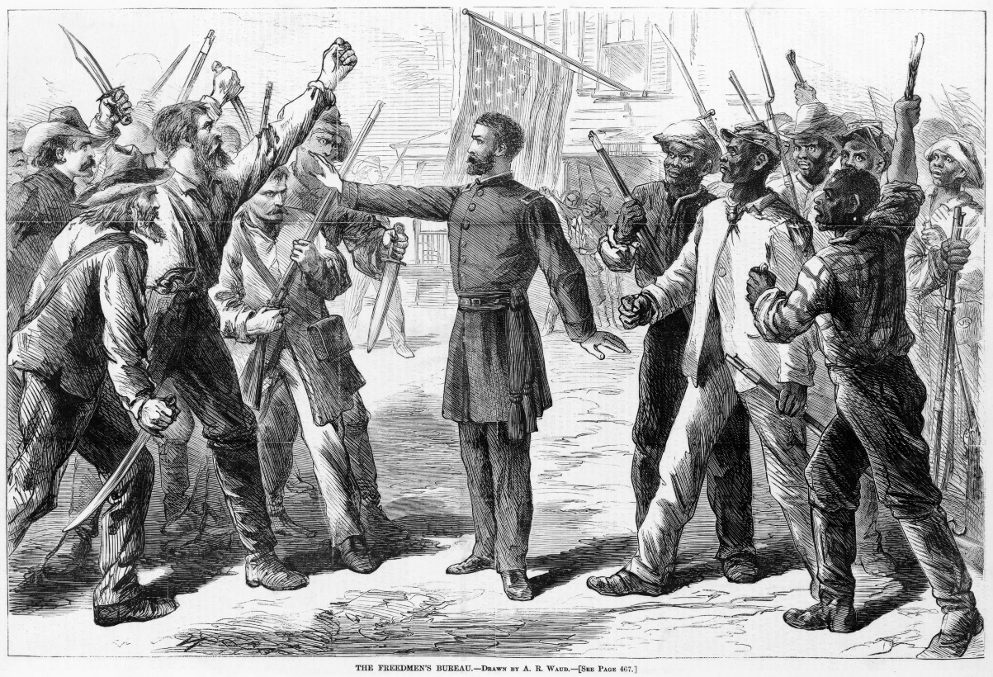
The Freedman’s Bureau
Former slaves were often referred to as freedmen.
The Freedmen’s Bureau was a government agency whose job was to provide relief to the thousands of people, black and white, who had been left homeless by the Civil War.

Slide 7
Two Plans for reconstruction
Lincoln and Johnson wanted…
Congress Wanted…
To restore the Union as quickly as possible
To go easy on the South
Stricter standards for admitting the Southern States back into the Union
To protect the freedom of African Americans in the South

Slide 8
Southerners oppose reconstruction
Texas elected ex-Confederates to Congress in an attempt to counter the Radical Republican control of Congress.
Texan representatives refused to ratify the 13th, 14th, and 15th amendments which granted rights to African Americans.
Southern states enforced black codes, or laws limiting the rights of African Americans.
The Ku Klux Klan (KKK) used violence and threats to prevent African Americans from voting.
As a response to Southern opposition, Congress declared military rule in the South until states met certain requirements of Reconstruction.

Slide 9
Reconstruction Ends
On March 30, 1870, President Ulysses S. Grant signed a proclamation that Reconstruction in Texas was over. By the end of the year, all of the Southern states had rejoined the Union on the Radical Republicans’ terms.

