Slide 1
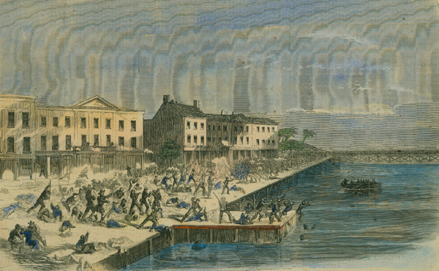
Battle of Galveston
Date: January 1, 1863
Casualties: 600 Union soldiers, 50 Confederate soldiers
Summary: After losing Galveston to Union troops in October 1862, the Confederacy was more determined than ever to recapture one of its most important ports. At 3:00 am on New Year’s Day, 1863, four Confederate gunboats appeared, coming down the bay toward Galveston. Soon afterward, the Rebels also began a land attack. Confederate troops killed most of the Union forces in Galveston and also captured many Union ships. Union forces even blew up one of their own ships to prevent it from being captured by the Confederates. By 10:00 am, Galveston was in Confederate hands again, although the Union blockade would limit trade in and out of the harbor.

Slide 2
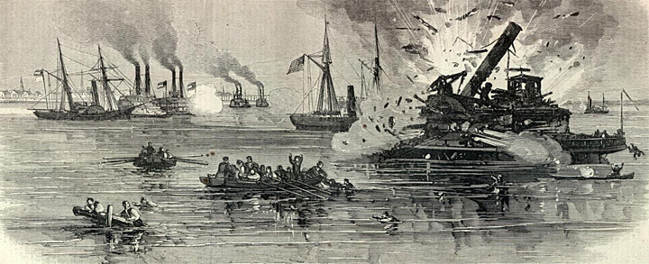
1. Why was control of Galveston important to both the North and South?
2. Where did most of the battle take place (land or water)? Why?

Slide 3
Excerpt from the Emancipation Proclamation
“And by virtue of the power, and for the purpose aforesaid, I do order and declare that all persons held as slaves within said designated States [Arkansas, Texas, Louisiana, Mississippi, Alabama, Florida, Georgia, South Carolina, North Carolina, and Virginia], and parts of States, are, and henceforward shall be free; and that the Executive government of the United States, including the military and naval authorities thereof, will recognize and maintain the freedom of said persons.
And I hereby enjoin upon the people so declared to be free to abstain from all violence, unless in necessary self-defence; and I recommend to them that, in all cases when allowed, they labor faithfully for reasonable wages.
And I further declare and make known, that such persons of suitable condition, will be received into the armed service of the United States to garrison forts, positions, stations, and other places, and to man vessels of all sorts in said service.”
U.S. President Abraham Lincoln January 1, 1863

Slide 4
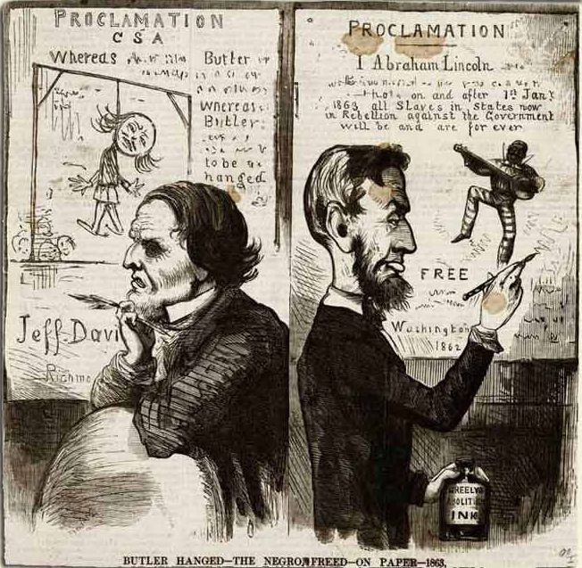
1. According to the excerpt and political cartoon, what is Abraham Lincoln’s motivation behind the Emancipation Proclamation? What is Jefferson Davis’s reaction?
2. Why would most slaves NOT find out about the Emancipation Proclamation until the end of the war?

Slide 5
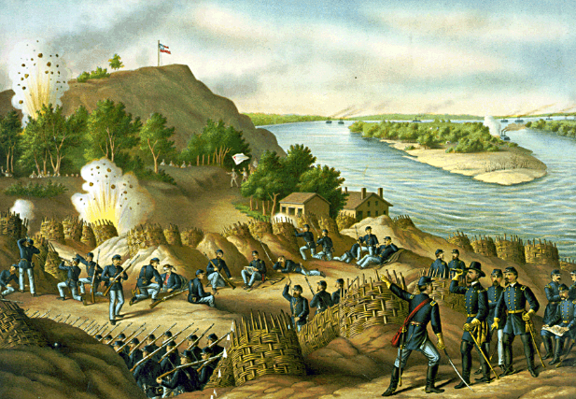
Siege/Battle of Vicksburg
Dates: May 22, 1863 – July 4, 1863
Casualties: 4,835 Union soldiers; 32,697 Confederate soldiers (29,495 surrendered)
Summary: As part of the Anaconda Plan, the Union aimed to capture the city of Vicksburg, strategically located on the Mississippi River. After two unsuccessful attacks on Vicksburg by Union forces, Gen. Grant decided to begin a siege of the city. The Confederates, under the command of Gen. Pemberton, had constructed strong defenses, but they became weaker as the siege raged on. Pemberton requested reinforcements which never came. Confederate food and supplies dwindled whereas the body count, and stench, increased on both sides. While the Confederates were trapped, the Union army grew and continued to attack. Conditions became so awful in Vicksburg that on June 28, Pemberton received an anonymous note from one of his men requesting a surrender before the army could abandon him. After days of negotiation, Pemberton surrendered to Grant on July 4. The South had lost control of the Mississippi River and was disconnected from Texas, Louisiana, and Arkansas.

Slide 6
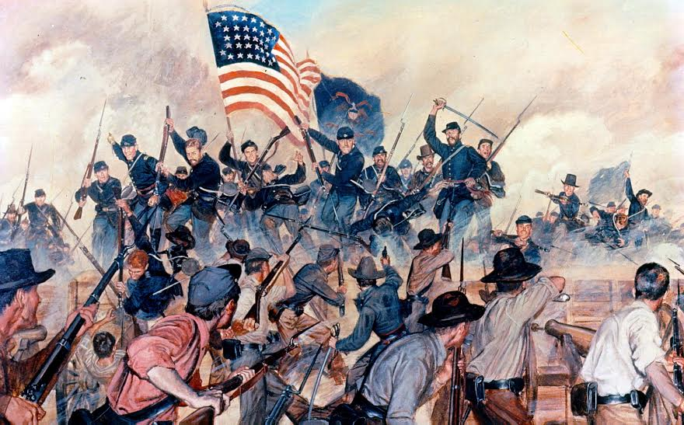
3. How did the Union victory at Vicksburg help fulfill the goals of the Anaconda Plan?
4. Make at least THREE comparisons between the Alamo and Vicksburg.

Slide 7
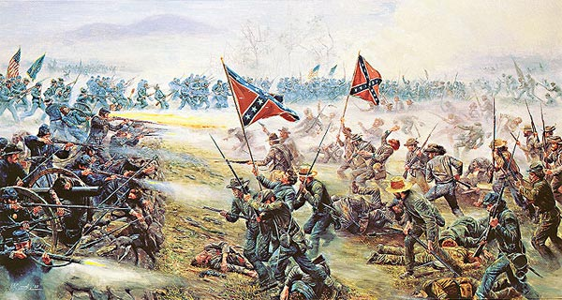
Battle of Gettysburg
Dates: July 1st – 3rd, 1863
Casualties: 23,055 Union soldiers; 23,231 Confederate soldiers
Summary: The battle took place over three days. On the first day, the armies were still coming together. The Confederates outnumbered the Union the first day and caused them to retreat through the town of Gettysburg to the south side of town. General Lee wanted his men to continue the attack and finish off the Union troops. However, his men delayed, and the Union had the opportunity to dig in and set up their defenses. By the second day, the armies from both sides were at full force. The Union had around 94,000 soldiers and the Confederates around 72,000. Lee attacked, and there was fierce fighting throughout the day with both sides taking heavy losses. On the third day, General Lee decided to make an all-or-nothing attack. He felt if he could win this battle, the South would win the war. He sent General Pickett, with 12,500 men, on a direct charge at the heart of the Union Army. This famous attack is called Pickett's Charge. Pickett's men were defeated with over half of them injured or killed. General Lee and the Confederate Army retreated and would never come close to gaining Union ground again. The Battle of Gettysburg was the deadliest battle of the Civil War.

Slide 8
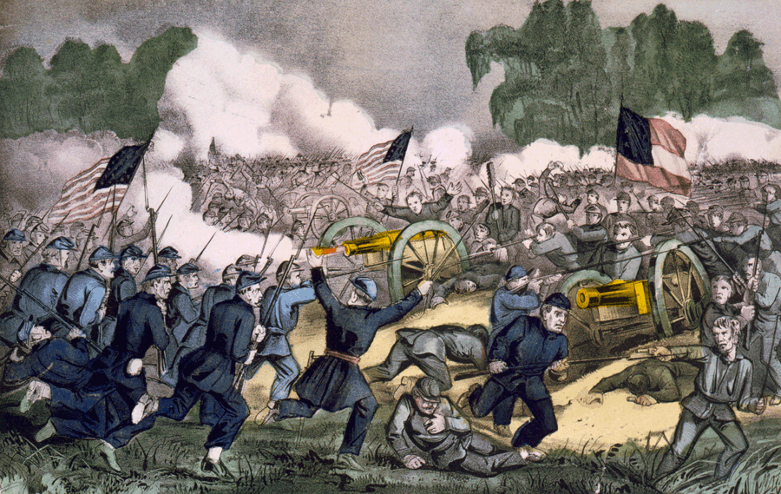
5. Why was victory at Gettysburg so important to General Lee?
6. Why was Gettysburg considered a turning point in the war for the Union?

Slide 9
The Gettysburg Address
“Four score and seven years ago our fathers brought forth on this continent, a new nation, conceived in Liberty, and dedicated to the proposition that all men are created equal.
Now we are engaged in a great civil war, testing whether that nation, or any nation so conceived and so dedicated, can long endure. We are met on a great battle-field of that war. We have come to dedicate a portion of that field, as a final resting place for those who here gave their lives that that nation might live. It is altogether fitting and proper that we should do this.
But, in a larger sense, we can not dedicate — we can not consecrate — we can not hallow — this ground. The brave men, living and dead, who struggled here, have consecrated it, far above our poor power to add or detract. The world will little note, nor long remember what we say here, but it can never forget what they did here. It is for us the living, rather, to be dedicated here to the unfinished work which they who fought here have thus far so nobly advanced. It is rather for us to be here dedicated to the great task remaining before us — that from these honored dead we take increased devotion to that cause for which they gave the last full measure of devotion — that we here highly resolve that these dead shall not have died in vain — that this nation, under God, shall have a new birth of freedom — and that government of the people, by the people, for the people, shall not perish from the earth.”
U.S. President Abraham Lincoln November 19th, 1863

Slide 10
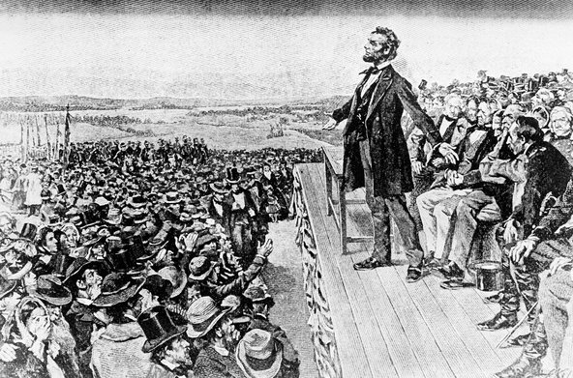
3. What is the overall tone of the Gettysburg Address? How do you think the audience reacted?
4. Why do you think Lincoln felt the need to make the Gettysburg Address? What purpose did it serve?

Slide 11
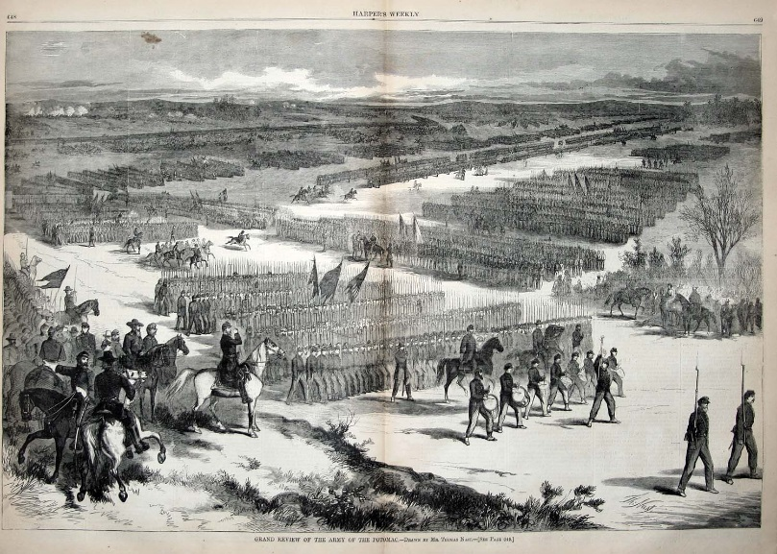
Battle of Sabine Pass
Date: September 8th, 1863
Casualties: 230 Union soldiers, 0 Confederate soldiers
Summary: A year prior to the battle, the Union had taken control of the Sabine River in an effort to strengthen their blockade of southern ports. On the day of the battle, Union Lieutenant Fredrick Crocker entered the pass with 4 gunboats and 18 navy vessels waiting in the Gulf with more troops. The U.S. Army wanted to invade Texas, which was difficult to control because of its size. The Confederate troops, although greatly outnumbered, were well trained and ready for the attack. Confederate Lieutenant Dowling ordered his men to open fire from afar, and with deadly accuracy, they wrecked havoc on the Union vessels. The Union Army was forced to withdraw down the river after having lost two gunboats and 200 captured sailors. The Confederates were not believed to have suffered any casualties.

Slide 12
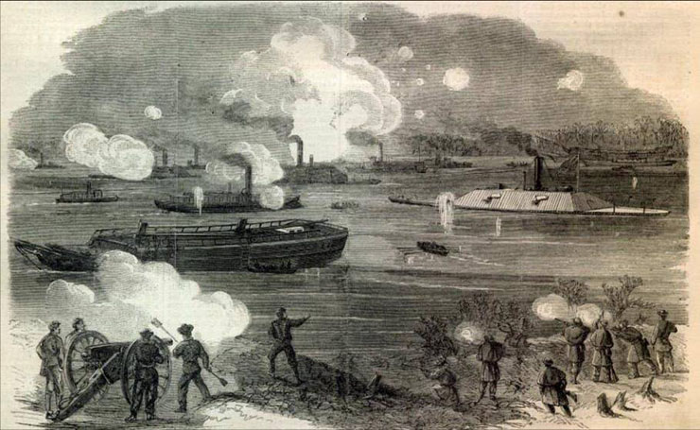
7. Why was it difficult to gain control of Texas during the war?
8. Based on the image, why do you think the Union’s plan to attack up the Sabine River was ineffective?

