Slide 1
Warm-Up
“We rely greatly on the sure operation of a complete blockade of the Atlantic and Gulf ports soon to commence. In connection with such blockade we propose a powerful movement down the Mississippi to the ocean…”
The excerpt most likely refers to…
Battle of Fort Sumter
First Battle of Bull Run
Anaconda Plan
Battle of Antietam

Slide 2
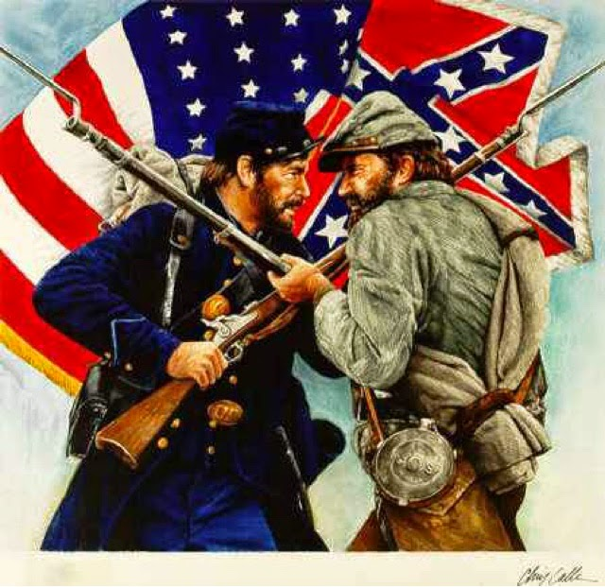
The War Continues
As the war raged on into 1862, both Confederate and Union troops traded victories and losses.
Just like the beginning of the war, it was not clear which would eventually win.

Slide 3
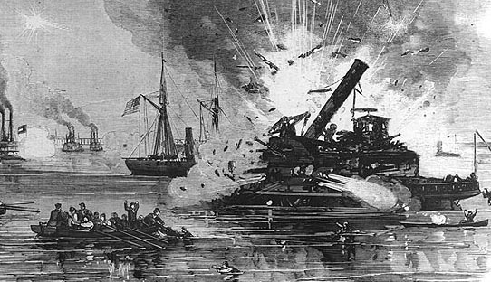
The Civil War in Texas: Galveston
As part of the Anaconda Plan, Union troops captured Galveston in October 1862 to block trade between the Confederacy and Europe.
Confederate troops attacked Union troops in an attempt to regain control of Galveston on January 1, 1863.
Union troops were taken by surprise –they soon became overwhelmed and surrendered.
By 1864, Galveston was one of the few open ports still available to the Confederacy.
Notes:
Also battles at Sabine Pass and Brownsville

Slide 4
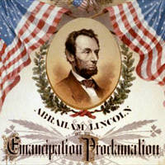
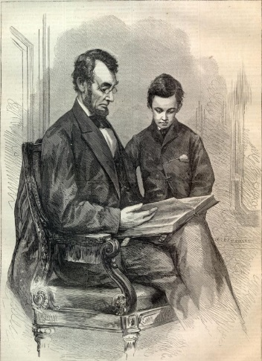
Emancipation Proclamation
Early in 1863, in the middle of fighting, Lincoln issued the Emancipation Proclamation.
This document freed the slaves only in the Confederacy, not in the Border States.
Most slaves would not find out about the Emancipation Proclamation until the end of the war.

Slide 5
Quick Question!
How did the Confederacy probably react to the Emancipation Proclamation?

Slide 6
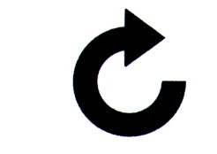
Turning Point: Vicksburg
Vicksburg, Mississippi was key to controlling the Mississippi River and a very important town for the Confederacy.
May 22, 1863: Union General Grant laid siege to the city for months, but the Confederates wouldn’t give up.
The Rebel troops were starving and forced to eat rats, and they melted down everything to make bullets and cannonballs.
July 4, 1863: Confederates surrendered, and the Union controlled the Mississippi.

Slide 7
Quick Question!
How is Vicksburg similar to another important event in Texas history? What event?

Slide 8
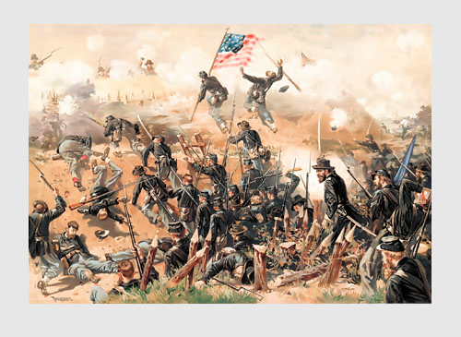
The Confederate’s Alamo
Just like the Siege/Battle of the Alamo, the army at Vicksburg held off a bigger army, this time for more than a month.

Slide 9
Turning Point: Gettysburg
While Vicksburg was falling, Confederate General Robert E. Lee wanted to attack the North in Gettysburg, Pennsylvania.
Lee sent wave after wave of soldiers at the Union, but they kept getting shot down.
52,000 men were killed over 3 days.
“The beginning of the end” for the Confederacy: They lost their best and brightest in Vicksburg and Gettysburg, and would never again attack the North.

Slide 10
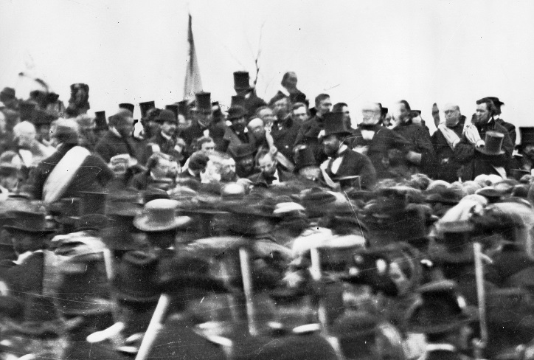
The Gettysburg Address
Gettysburg was by far the bloodiest battle of the Civil War.
The Gettysburg Address was a famous speech made by President Lincoln in which he called for the preservation of the Union to honor those who died.
“Four score and seven years ago” referred to the Declaration of Independence, which was signed 87 years before the Battle of Gettysburg.

