Slide 1
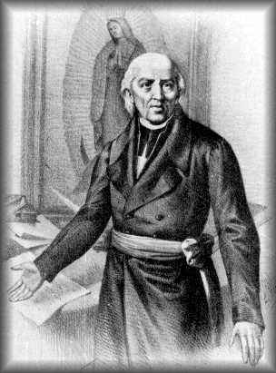
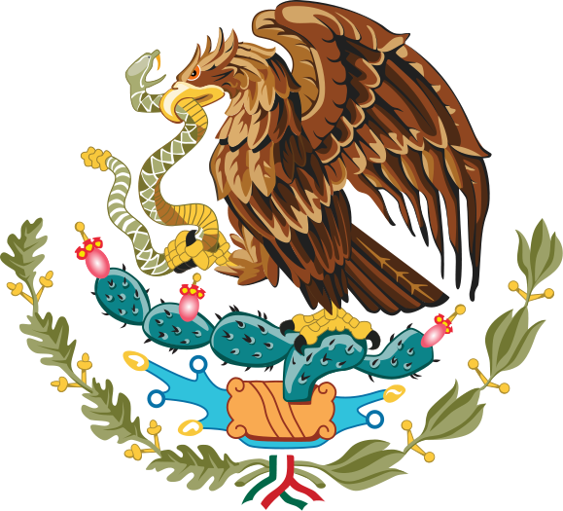
Mexico Gains Independence
1810 - 1821

Slide 2
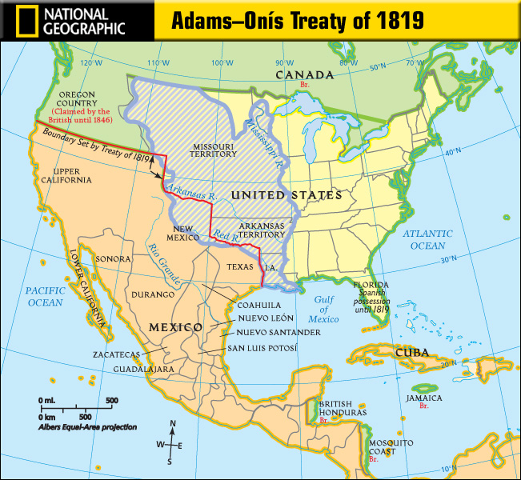
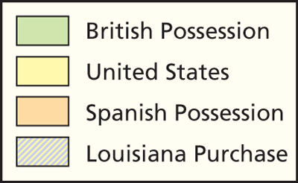
Spanish Empire
Red River and Sabine River officially become New Spain’s borders

Slide 3
People of the Spanish Empire
Spaniards (Peninsulares) = people who came directly from Spain to live in the New World
Criollos = people of pure Spanish blood but born in New Spain (New World)
Mestizos = people of mixed Native American and Spanish blood
Mulattos = people of mixed African and Spanish blood
Blacks
Native Americans

Slide 4
Social Classes in the Spanish Empire
Estimated population figures of New Spain in 1800

Slide 5
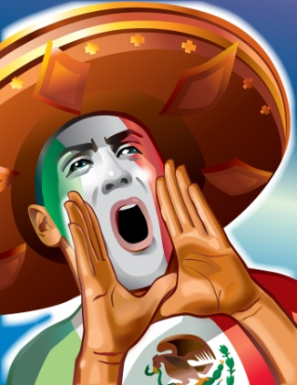
Reasons for Revolution:
Tired of Spanish Rule
Jobs
  best jobs in New Spain were saved for the Spaniards (not Criollos, Mestizos, Native Americans or Blacks).
Taxes
  Spanish were taxing Mexicans to pay for their wars overseas.

Slide 6
Inspiration for Revolution:
American Revolution 1776 - The U.S. fights Great Britain for their independence
French Revolution 1789 - The French rise up against their king and create a new government

Slide 7
Leader of the Mexican Revolution
Father Miguel Hidalgo -
  Catholic Priest & “Father of the Country”
  September 16, 1810 - he called Mexicans to fight Spain for their freedom
  “Grito de Dolores” – The Scream

Slide 8
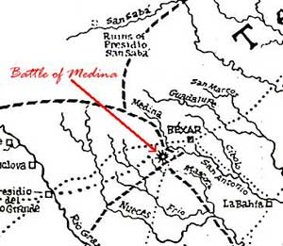
Texas Involvement
Jose Bernardo Gutierrez de Lara and Augustus Magee
  Lead expedition across Texas defeating Spanish Army as they go.
  Capture Nacogdoches, Goliad, and
  San Antonio
Battle of Medina
  Bloodiest battle on Texas soil
  About 1300 Republican (Mexican Army for Independence) men killed
  Texas remains under Spanish rule

Slide 9
Turning Point
For most of the war the lower classes struggle to fight, winning small battles
An 1820 revolt from the people in Spain cause the king to lose some of his power
The king loses control of New Spain and some upper classes work with lower classes to gain independence by 1821

Slide 10
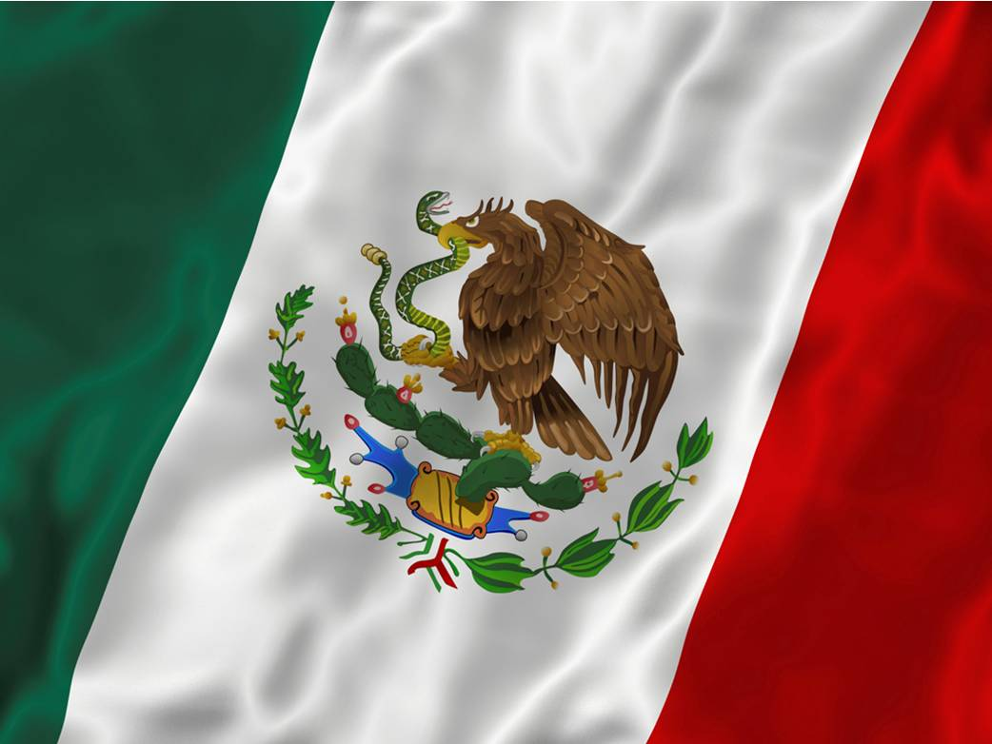
Outcome of the War
11 year war
Mexico became an independent country in 1821
Texas became a province (state) of Mexico called Coahuila y Tejas.
A great pride for a new culture…MEXICAN!

Slide 11
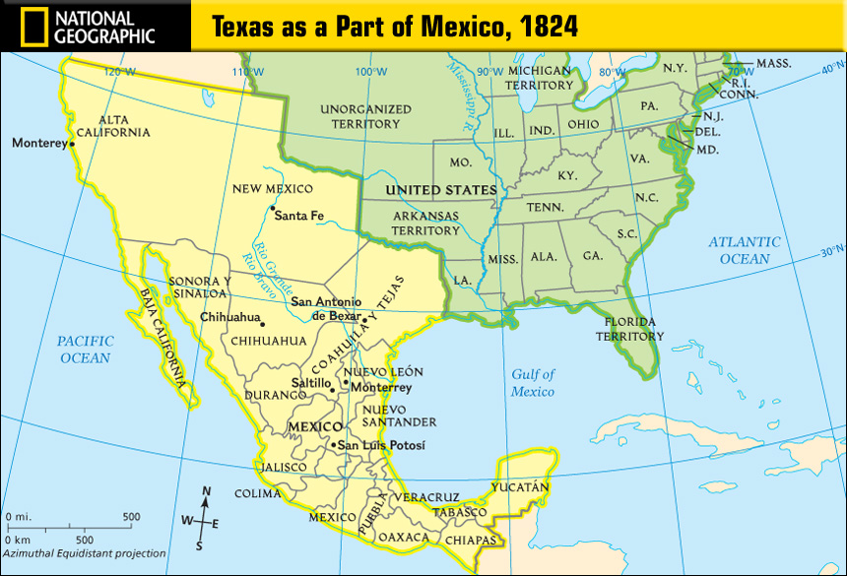
New Spain’s Provinces (States)

Slide 12
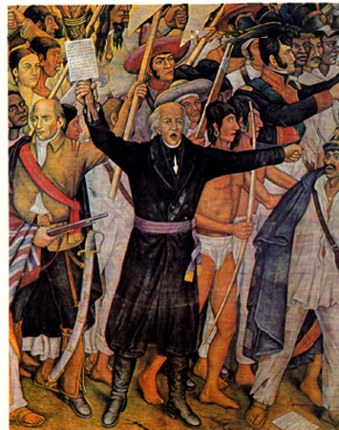

Slide 13
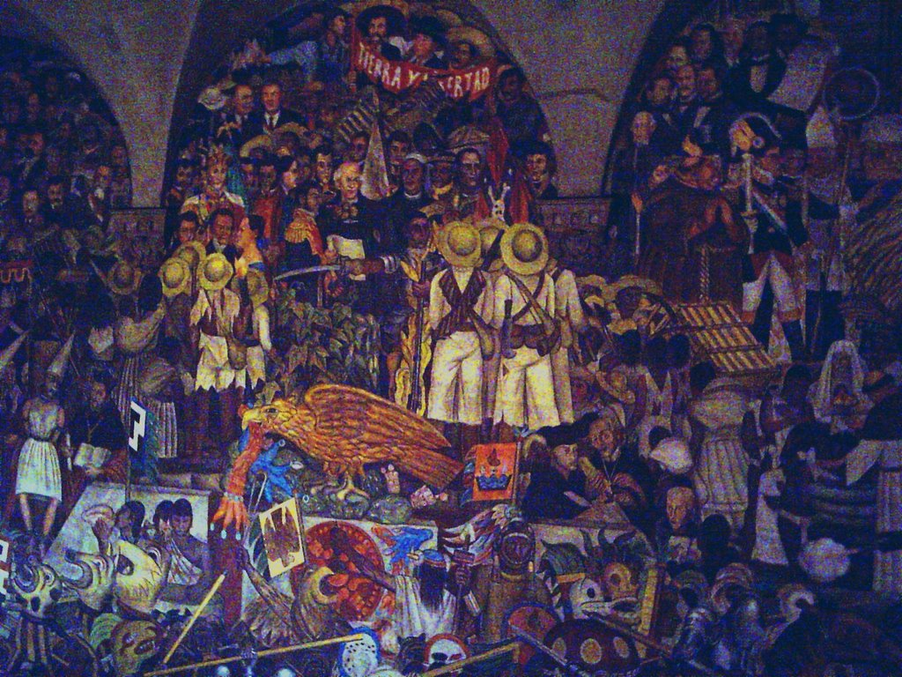

Slide 14
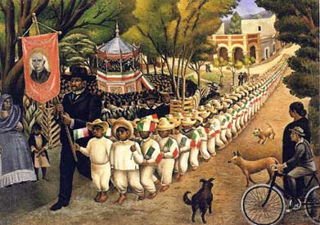

Slide 15
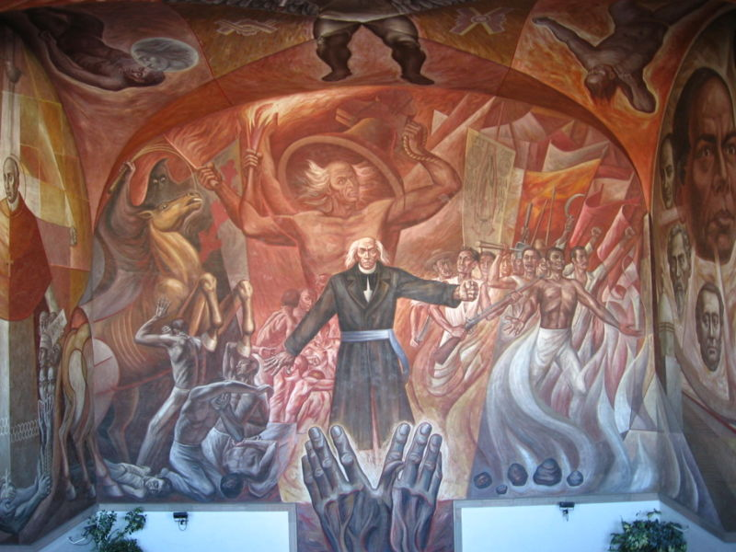

Slide 16
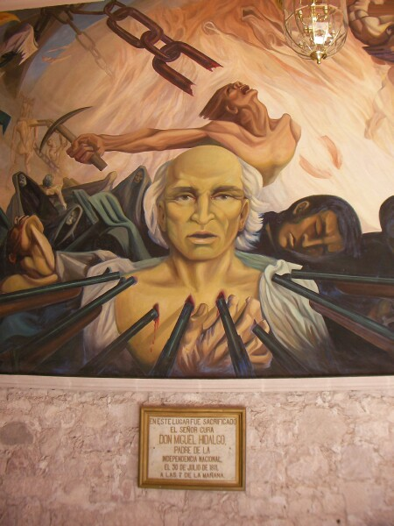

Slide 17
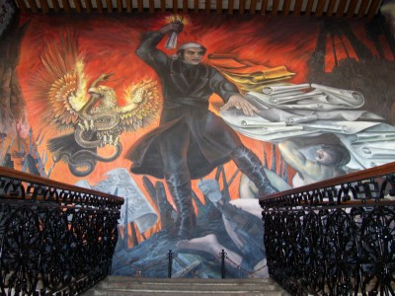
Jose Morelos

