Slide 1
Expanding Territory

Slide 2
Review
French come to Texas and leave, but they claim Louisiana for France.
Spanish become the only remaining European power in Texas.

Slide 3
Meanwhile…
American Revolution (1775-1783)
French Revolution (1789-1799)

Slide 4
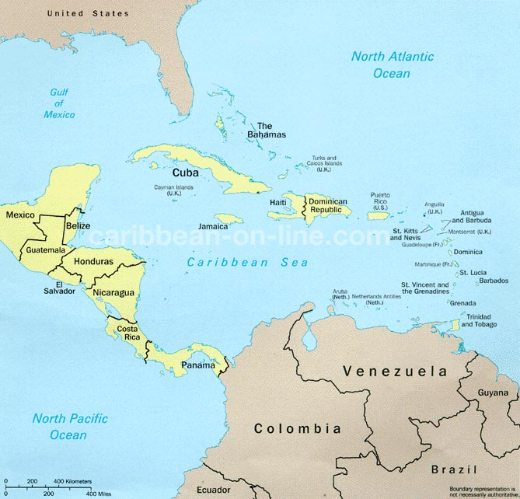
France in the New World
France acquires Haiti
Haitians win independence
The French decide to withdraw from most of North America and need to decide what to do with one very large territory…

Slide 5
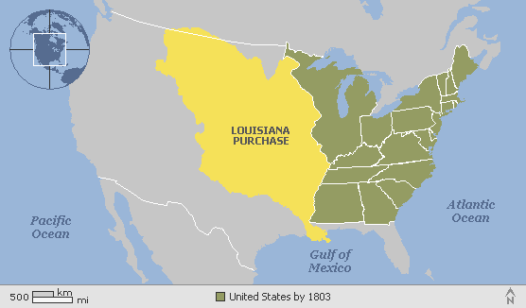
Louisiana Purchase (1803)
Sold to United States for $15 million – a bargain!

Slide 6
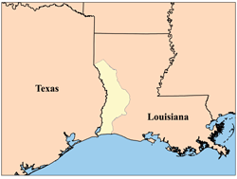
Conflict over Borders
The U.S. wants American territory to extend to the Sabine River and maybe even include Texas.
Spain wants Texas to extend to the Calcasieu River in Louisiana.
Neutral Ground

Slide 7
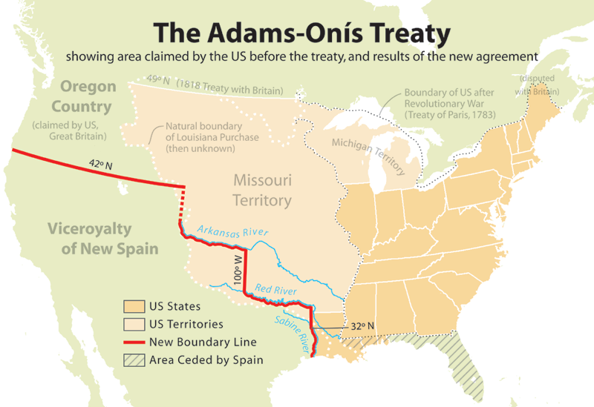
1819

