Slide 1
Advertisement for the play President Lincoln would attend on April 14, 1865

Slide 2
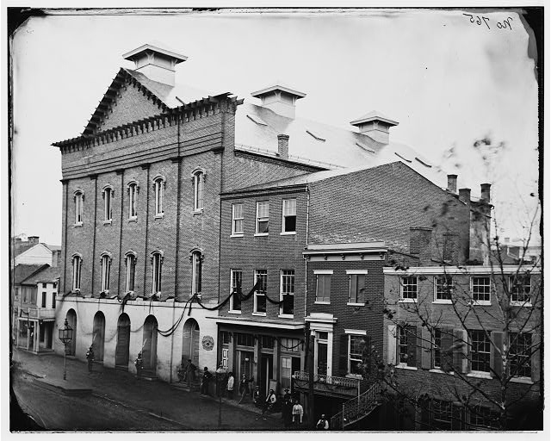
Ford’s Theatre in Washington D.C., the location of President Lincoln’s assassination on April 14, 1865

Slide 3
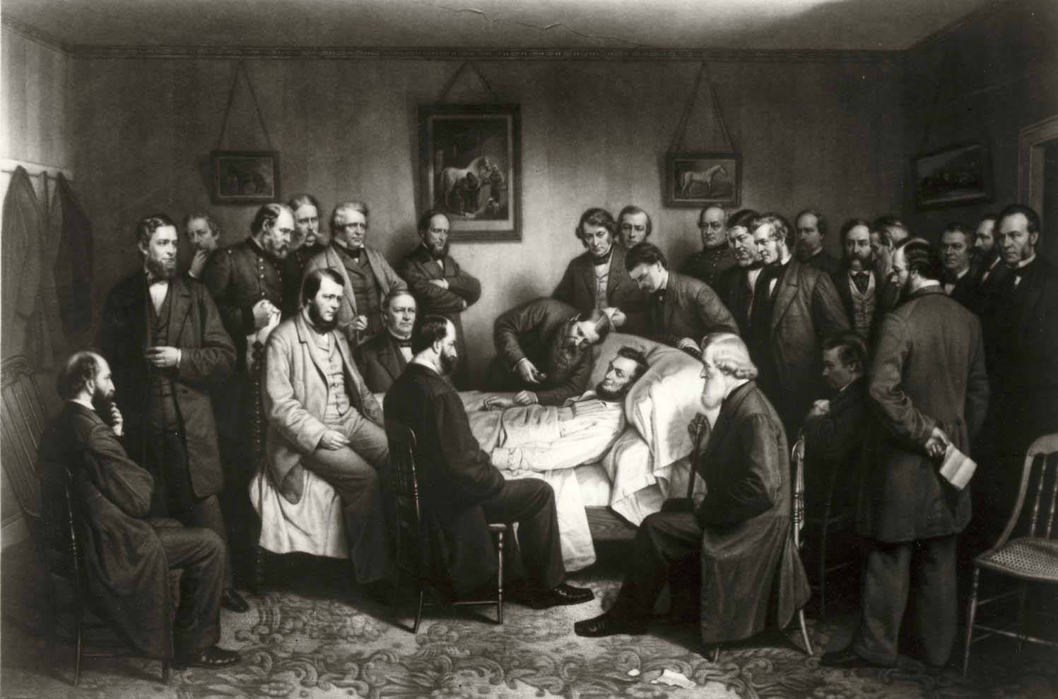
Mourners gathered around President Lincoln’s deathbed late in the night and into the early morning of April 15, 1865 across the street from Ford’s Theatre in the Petersen House

Slide 4
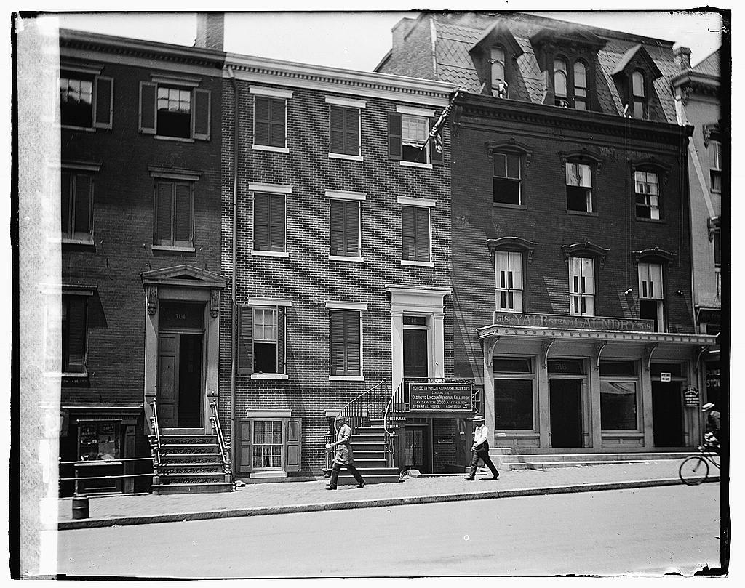
The Petersen House, across the street from Ford’s Theatre, where President Lincoln died on April 15, 1865

Slide 5
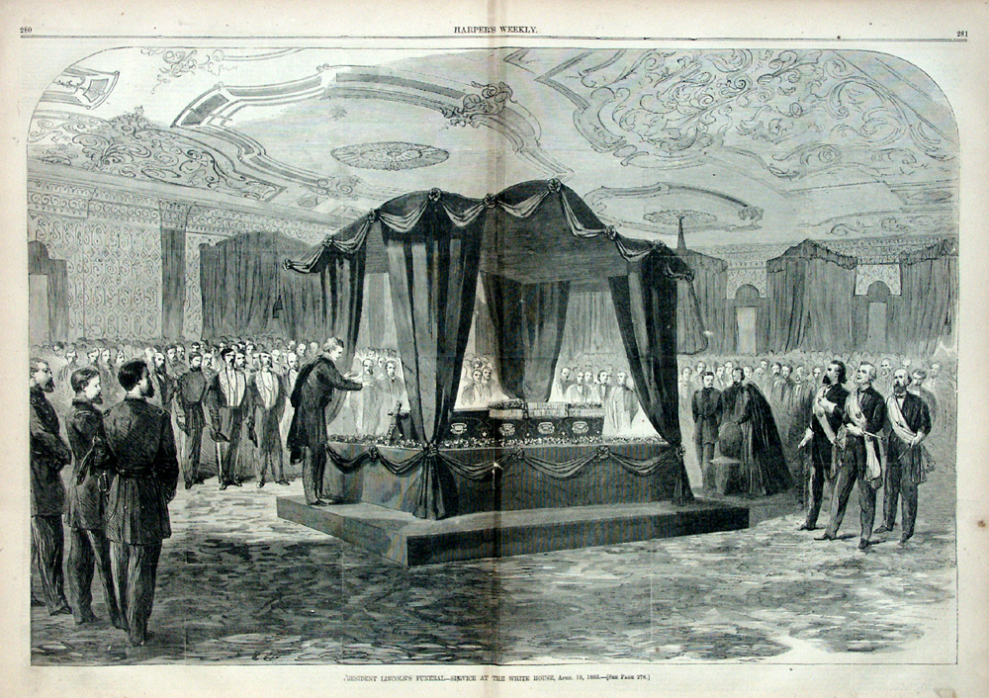
President Lincoln’s coffin lying in state for public viewing

Slide 6
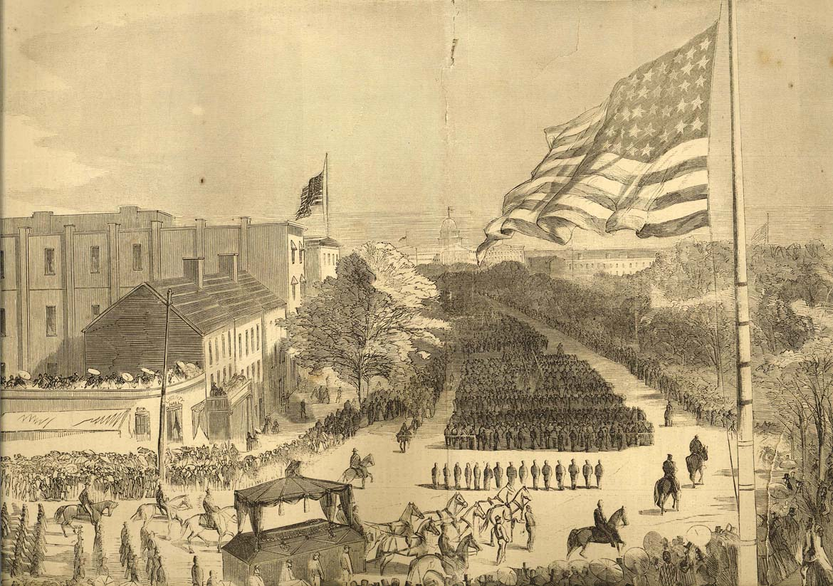
The funeral procession of President Lincoln through Washington D.C.

Slide 7
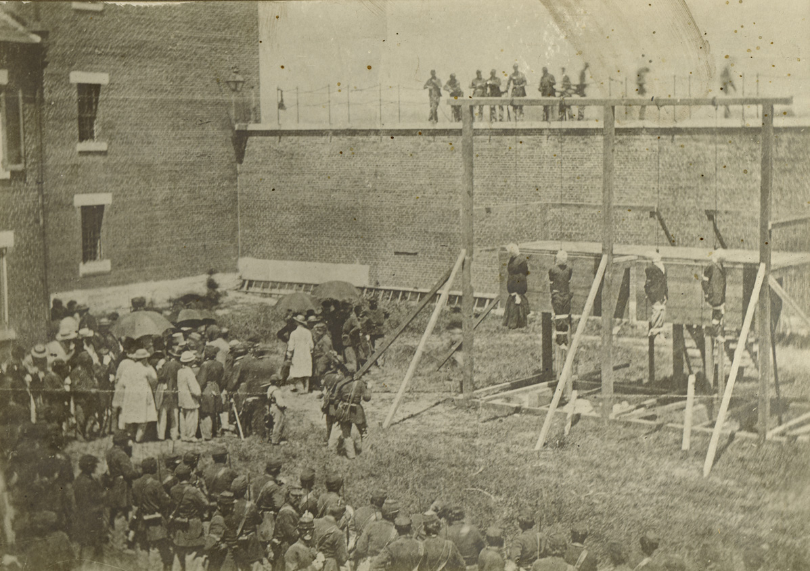
John Wilkes Booth’s co-conspirators were tried and later hanged on July 7, 1865
(From left to right: Mary Surratt, Lewis Powell, David Herold, and George Atzerodt)

Slide 8
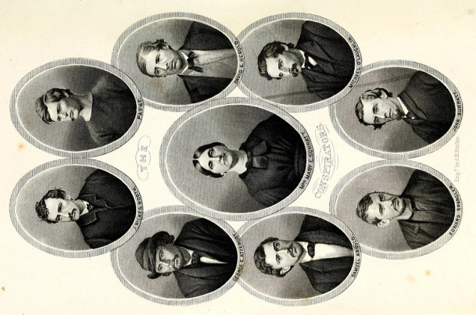

Slide 9
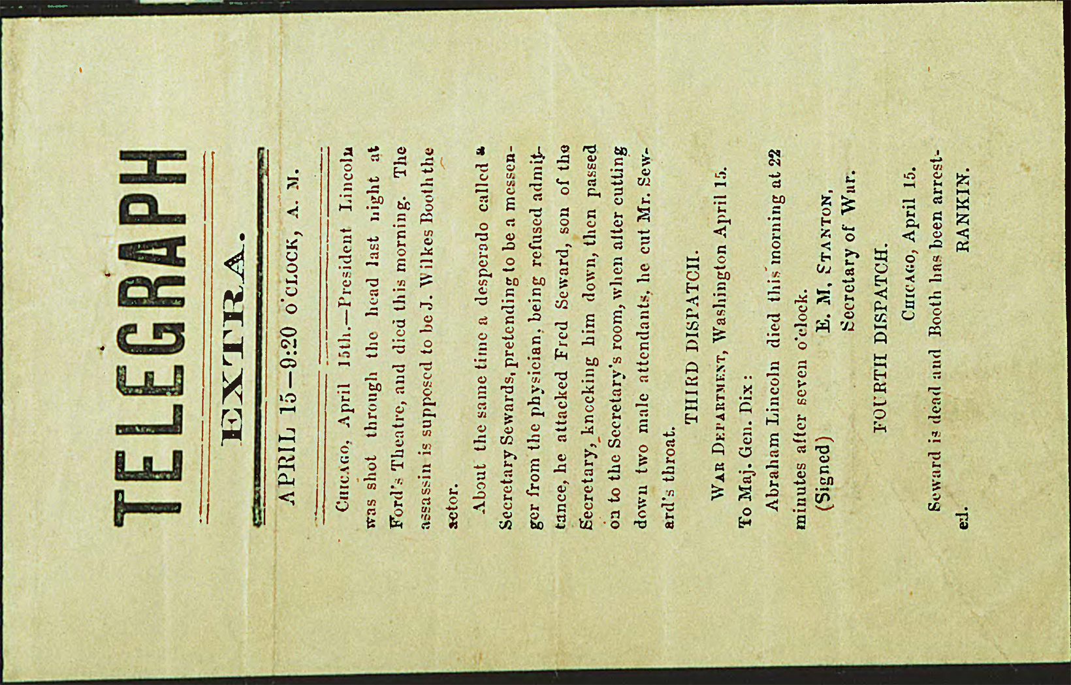

Slide 10
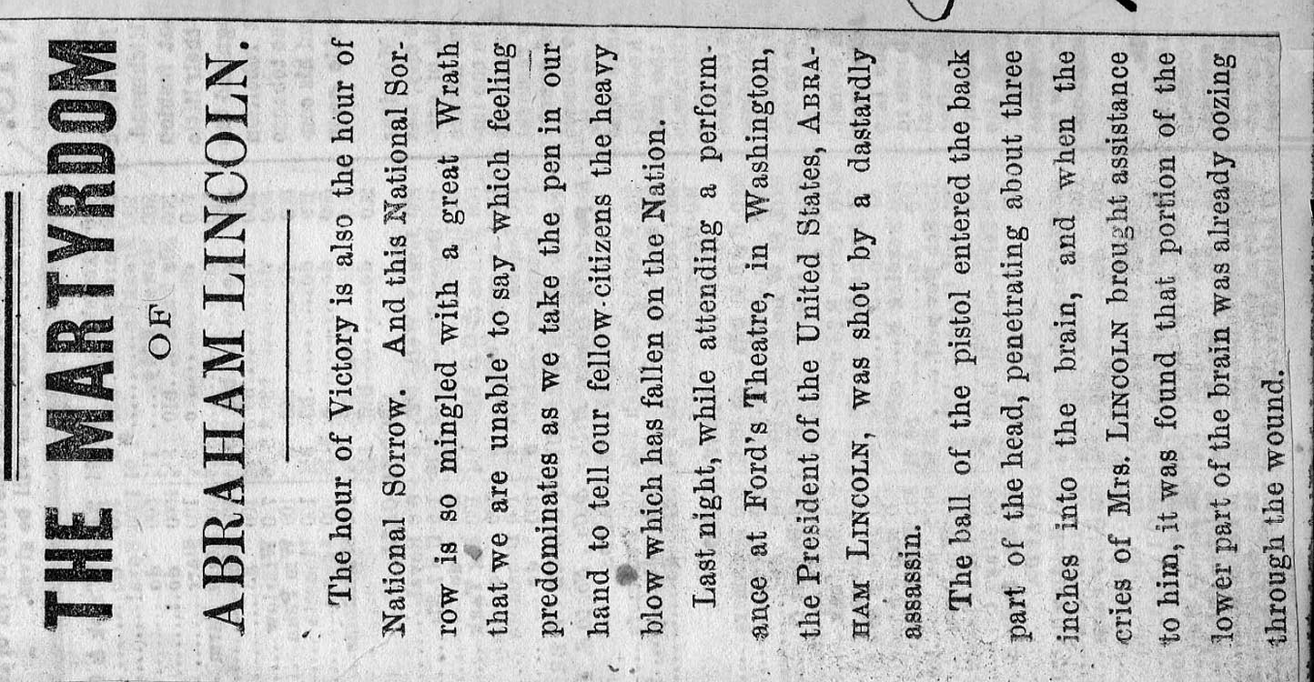

Slide 11
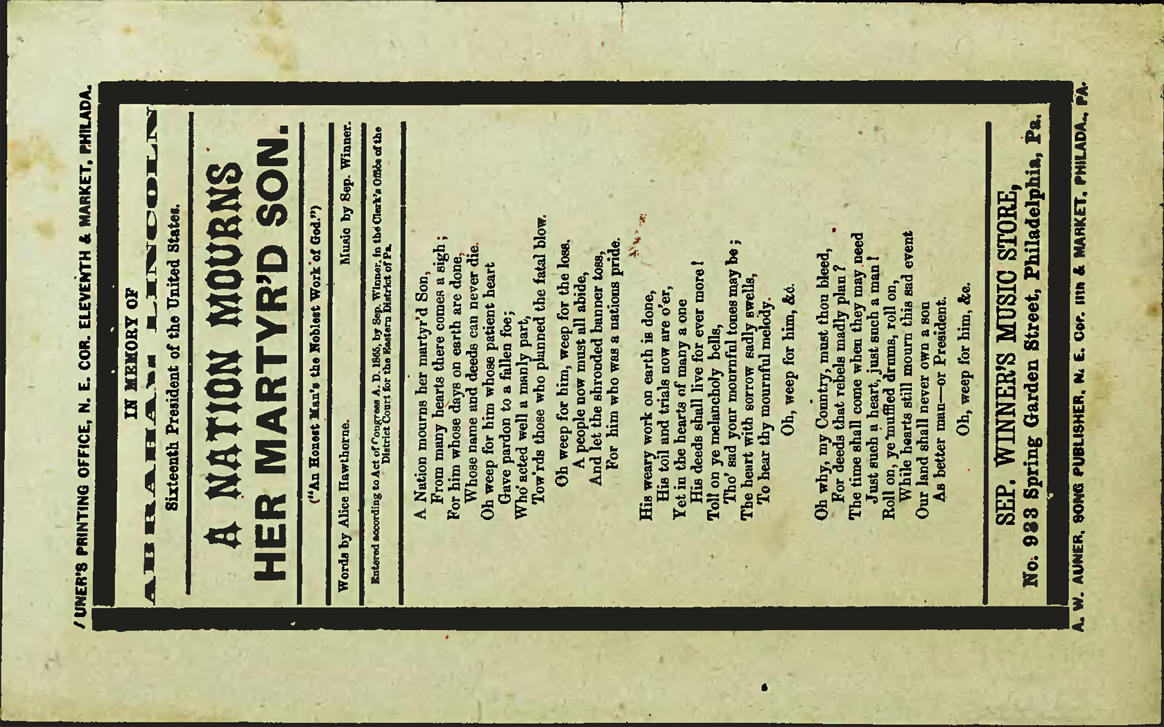

Slide 12
