Slide 1
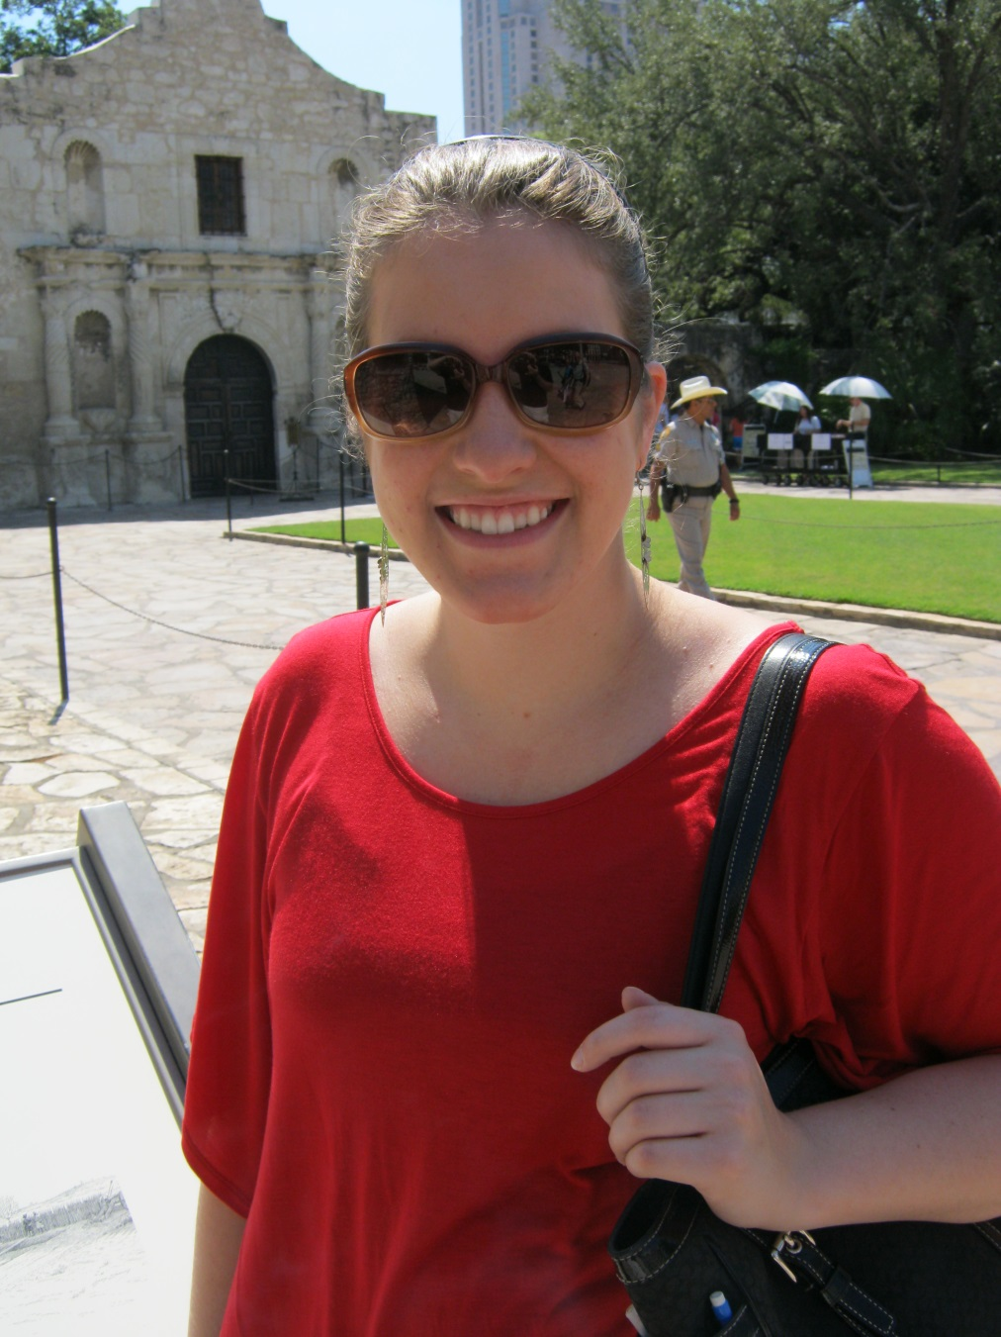
Ms. Brame
B.A. in History & Composite Social Studies
M.A. in Teaching

Slide 2
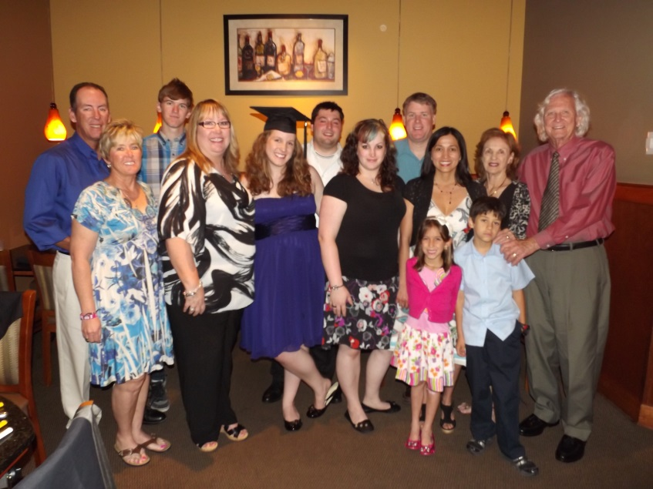

Family

Slide 3
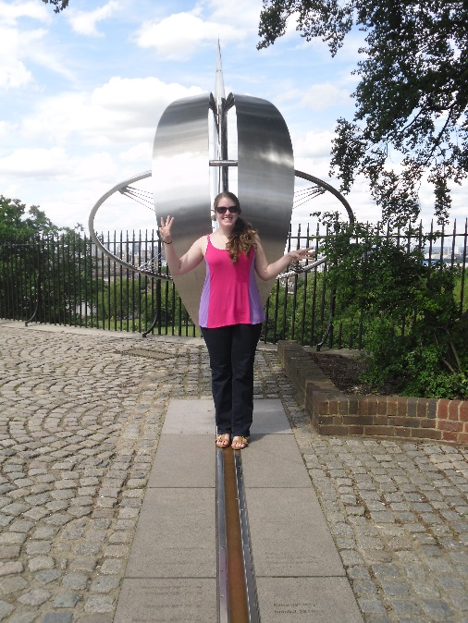

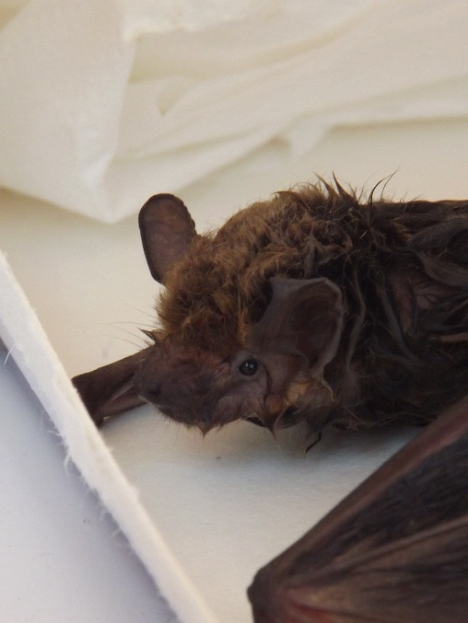
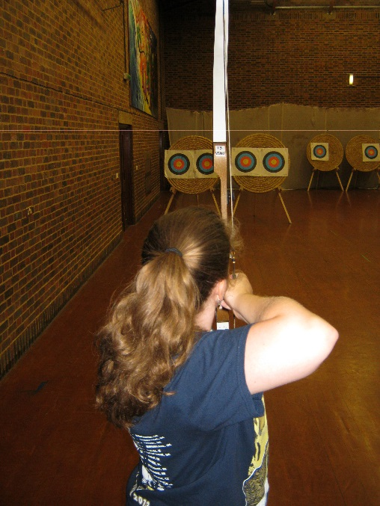
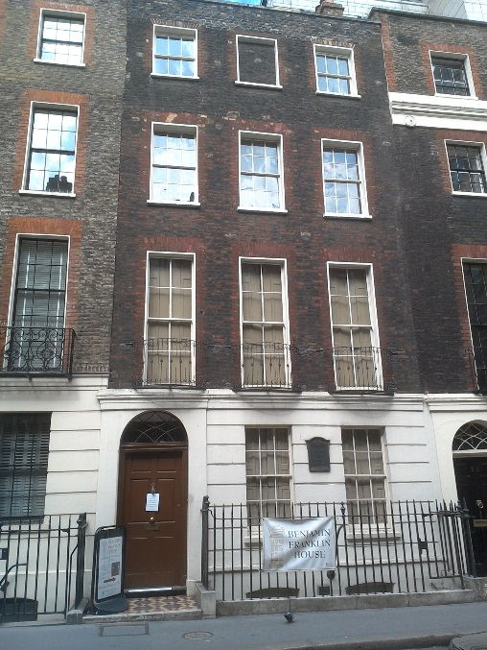
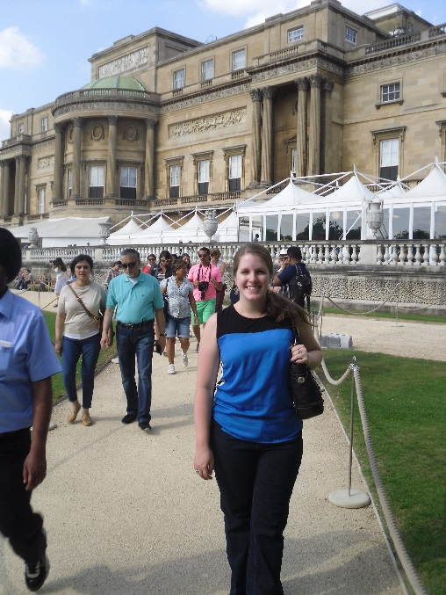
Summer
Notes:
Benidorm, Buckingham Palace, Benjamin Franklin House

Slide 4


These are a few of my favorite things…

Slide 5
Classroom Rules, Roles, and Procedures

Slide 6
Classroom Rules
Follow LMS rules and expectations at all times.
Arrive to class on time with required materials.
Respect everyone and everything.
Raise your hand to ask questions and contribute to discussion.
Follow directions the first time they are given.
No talking when others have the floor.
No arguing with the ref.

Slide 7
Consequences
1st offense = Warning
2nd offense = Student-teacher conference
3rd offense = Parent contact
Repeat or severe offense = Office referral and parent-teacher conference

Slide 8
Entering the Classroom
Walk in quietly
Sit in your assigned seat
Look at the “Do First” – this will usually pertain to getting out supplies or homework
Copy the agenda/homework into your planner
Begin warm-up if applicable

Slide 9
Turning in Assignments
You will be assigned a number
Place this number in the upper right hand corner of all your assignments
Collectors are responsible for picking up assignments and organizing them into number order
Once all assignments have been collected, collectors will report the missing numbers to Ms. Brame
Collectors place assignments in the class period drawer

Slide 10
Missing Assignments
All assignments are meaningful!
If you fail to complete ANY assignment (graded or not), you will be assigned lunch intervention with Ms. Brame for the Monday following the due date
Late assignments will be accepted for up to 80% of the original point value

Slide 11
Returning Assignments
Once an assignment has been graded, I will clip them together and place back in class period drawer
Distributors will pass back graded assignments
Distributors will also pass out new handouts, supplies, textbooks, etc.
The 80% policy for all graded assignments applies

Slide 12
Restroom Policy
You must have YOUR planner filled out. Sharing of planners is not allowed.
No restroom 10 minutes before or after ANY bell.
No restroom when note-taking or while teacher is giving instruction.
It is OKAY to ask during independent work or when you have finished your assignment.
Restroom breaks should be taken before or after a quiz/test.
Frequency of restroom use will be monitored.
Abuse of this policy will result in loss of restroom privileges.

Slide 13
Tardies
Enter class quietly
Excused: Hand teacher pass
Unexcused: Sign in at The Border
Sit down and begin working
3 tardies = after school or lunch detention

Slide 14
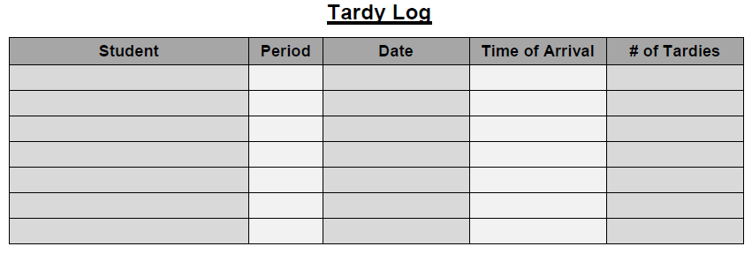
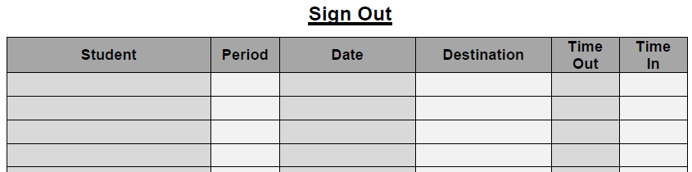
Entering and Leaving the Room
THE BORDER

Slide 15
Pencil Sharpening
Only before class, during work time, or after class
Raise pencil in air silently
Wait for Ms. Brame’s response (thumbs up or thumbs down)
Need to borrow a pen/pencil? I need collateral.

Slide 16

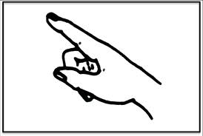
Hand Signals
Restroom
Pencil Sharpening

Slide 17
Absences
Look at website for all notes and assignments
Get hardcopies of the work you missed in the student center
  Check the calendar
  Look in the blue sorter
Make up any missed work and hand in the NEXT class period
Take any quizzes/tests or hand in projects the SAME day you return

Slide 18
Fire Drill
Remain seated
Line up quickly and quietly when told do so
Exit through the fire door in line
Stay together
Stay SILENT
Line up single-file once outside

Slide 19
Dismissal
Return all supplies
Clean your table and floor area
I will not dismiss you until everyone is quiet
Wait for me to dismiss you, NOT the bell!
Push in your seat and walk calmly out of the room
R4 and P4 will stack chairs

Slide 20
BYOD
Sometimes, I will ask you to Bring Your Own Device
You are responsible for the care and safety of your device
Acceptable devices include smartphones, tablets, laptops, etc.
You may ONLY use the device for educational purposes and ONLY on designated days – I will let you know beforehand!
Misuse of devices or use outside of class will result in loss of privileges, alternative assignments, and/or disciplinary action

Slide 21
Questions?

