Slide 1
Goliad & The Runaway Scrape

Slide 2
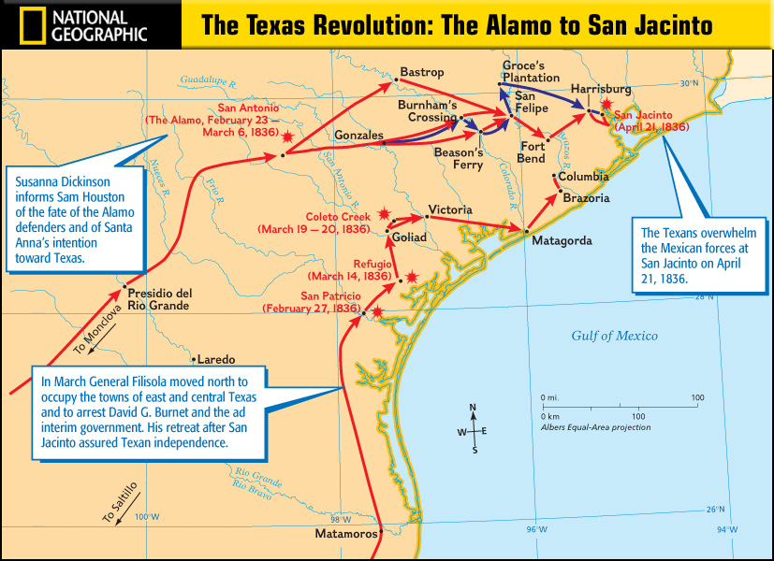
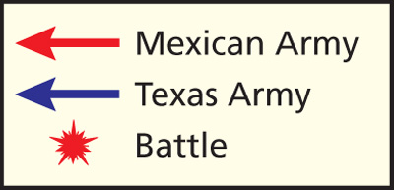
After the Alamo…
(Feb 22-Mar 6, 1836)
Colonel James Fannin and some Texans were in the town of Coleto Creek.
Sam Houston ordered them to retreat after the loss at the Alamo.
But Fannin delayed…

Slide 3
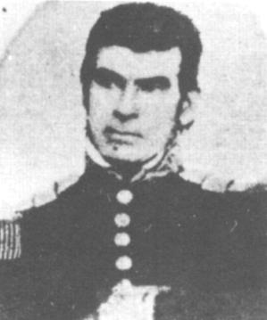
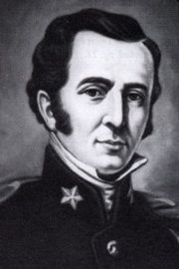
Massacre at Goliad
March 27, 1836
General Urrea surrounded Colonel James Fannin & the Texans at Coleto Creek
Texans surrendered at discretion
General Jose Urrea
Colonel James Fannin

Slide 4
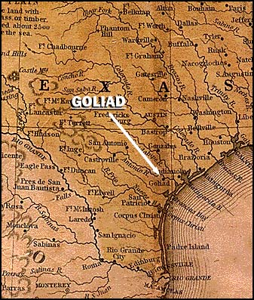
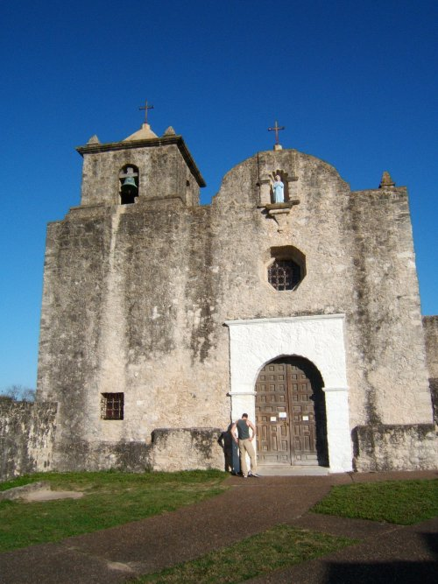
Massacre at Goliad
Urrea marched the Texans to Goliad
Santa Anna ordered the Texans to be massacred even though they surrendered

Slide 5
Massacre at Goliad
350 Texans were shot at gunpoint with only a few escaping
“Remember Goliad!” helped unite the Texans like the Alamo

Slide 6
The Runaway Scrape
March 11, 1836 – April 21, 1836
After the massacres at the Alamo and Goliad, Sam Houston ordered the Texans to retreat east across Texas in a zig zag pattern

Slide 7
The Runaway Scrape
Genius:
  Houston needed time to train his army and didn’t want to fight until he could take the Mexicans by surprise
Coward:
  Houston’s men wanted to fight and called him a coward for retreating

