Slide 1
Systems
Plains Culture groups based their lives and cultures on the buffalo. They relied on buffalo to provide them with all of their living essentials—food, shelter, clothing, weapons, and tools. In the spring and fall, the entire group would set out on the prairies to hunt buffalo. Tribes were often at war with other tribes over the areas with the most resources.

Slide 2
Environment
Most Plains Culture groups called the Great Plains their home, although some tribes lived in other regions of Texas. Large parts of North, West, and Central Texas were a sea of grass that provided a plentiful food supply for millions of buffalo. Plains Culture groups used tepees for shelter.

Slide 3
History of Culture
Historians estimate that many groups from the Plains Culture migrated to Texas in the 1600s and 1700s from mountainous areas of the north to the warmer climate of Texas where buffalo were more plentiful.

Slide 4
Jobs/Tools
All men were expected to become skilled hunters. Some men became warriors who fought against other tribes, and the highest position for a man was a chief, someone who led the tribe. Women tanned hides, tended crops, gathered wild foods, cooked, made clothing, and maintained the tepees. Both could be medicine men and women. Tools were made from the bones of buffalo. The most important tool and weapon was the bow and arrow.

Slide 5
Family and Life
Families formed the basis of social organization on the Texas plains. Groups of families banded together under the leadership of a chief. These groups were self-sufficient and independent. The warriors often held high status because of their bravery. Their dangerous hunting lives constantly tested the survival skills of these Native Texans.

Slide 6
Food
Plains groups relied on the buffalo for food, although some groups also hunted elk, deer, antelope, or rabbits. Once a buffalo was killed, members of the group removed and ate some of the animal’s organs immediately. They roasted most of the meat and preserved some by setting it out to dry into a form of jerky. The women pounded the dried meat and mixed it with nuts and berries. Plains groups also gathered plants for food.

Slide 7
Clothing
Buffalo hides provided material for much of the Plains Culture clothing. Fur added warmth in the winter. Moccasins provided protection for the feet. Many leaders, such as chiefs and warriors, wore elaborate feather headdresses to show their high status.

Slide 8
Transportation
Buffalo herds in Texas were constantly migrating. The Native Texan groups who followed the herds were nomads. Their dwellings had to be easy to take apart and carry on long journeys. Before horses were brought to Texas, these native groups domesticated dogs to drag their belongings from one place to another using small wooden sleds while the people travelled by foot. Later, horses became their primary beasts of burden.

Slide 9
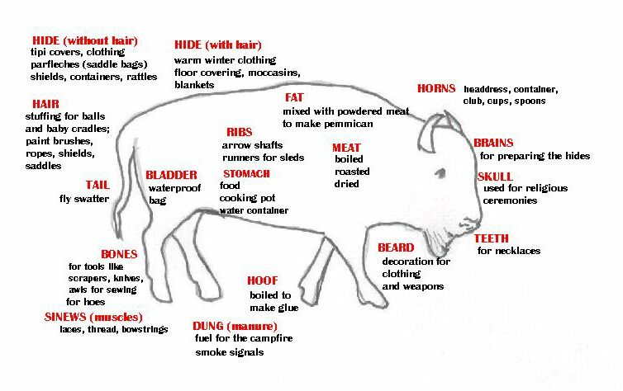

Slide 10
Systems
Some Pueblo Culture groups planted crops beside rivers and streams, but unless people lived along the Rio Grande, water was very limited. Additionally, some people hunted, but most groups relied heavily on trade due to the few resources in their environment. Overall, Pueblos were very peaceful.

Slide 11
Environment
Pueblos made their home in the Mountains and Basins. The climate was very dry with a limited water supply. Pueblos lived in square, flat-roofed adobe houses which helped keep the home cool in the summer and warm in the winter. Temperatures could even change drastically from day to night due to the mountainous and desert climate.

Slide 12
History of Culture
Many Pueblos migrated to the Mountains and Basins to flee warlike tribes in other areas of Texas. The Pueblo Culture was determined to maintain peace, so moving to the desert and mountains seemed like the best solution!

Slide 13
Jobs/Tools
Pueblos worked as farmers (along the Rio Grande), hunters, traders, and craftspeople. They made beautiful pottery and jewelry and wove clothing, blankets, and baskets. Pueblos used spears, clubs, bows, and arrows for hunting and defense. They used wooden rakes for farming and spindles and looms for weaving.

Slide 14
Family and Life
Pueblo Culture groups placed a strong emphasis on family. Most children had a huge extended family which included parents, grandparents, aunts, uncles, and cousins. Pueblo families shared their belongings – everything belonging to everyone in the family.

Slide 15
Food
Some Pueblos were able to grow crops such as corn, tomatoes, squash, beans, and grapes along the Rio Grande. Men hunted animals such as deer and antelope while women gathered nuts, fruits, and herbs. Food could also be obtained through trade.

Slide 16
Clothing
Pueblo men wore breechcloths or short kilts while women wore knee-length cotton dresses called mantas. Men and women both wore deerskin moccasins on their feet. Pueblos did not traditionally wear headdresses like the Plains Culture. Many Pueblos did wear paint on their faces to show other tribes they came in peace.

Slide 17
Transportation
Pueblos lived in permanent housing, so they did not need to travel much. However, when they needed to go somewhere, they would typically travel on foot.

Slide 18
Systems
The Southeastern Culture had complex societies that revolved around government, religion and farming. They built permanent housing and places of worship within their villages. They were controlled by a chief who, with the help of elder leaders, made decisions for the entire tribe/clan.

Slide 19
Environment
To be able to farm, trees in the area were cleared to make fields. They used the trees and grasses in the area to build their permanent houses. The climate was mild with enough rain to maintain their farming lifestyle.

Slide 20
History of Culture
The Southeastern Culture was spread throughout the southeastern United States. They had some of the most developed government and religions of any group in Texas. As they began to encounter the Europeans, most groups adopted a European lifestyle to be able to maintain their land.

Slide 21
Jobs/Tools
Most of the members of the Southeastern Culture were farmers and hunters. They also had craftspeople that created pottery, rugs, and baskets to trade with other tribes for items they needed. They developed specific farming tools to help with digging and harvesting.

Slide 22
Family and Life
The Southeastern Cultures’ families were led by the eldest women in the family. The head of the community was a male, but he still had to answer to the head of his family. The complex communities had much need for order, and they were organized by the male chiefs. They also looked to spiritual leaders for guidance.

Slide 23
Food
Food was abundant for this culture because of the fertile soil and access to water. They grew pumpkins, squash, beans, and corn. They still hunted the deer and bears in the area and picked fruit from trees not cleared for farming. They were even known to fish from nearby rivers and streams.

Slide 24
Clothing
Prior to the Spanish coming to Texas, the Southeastern clothing was mainly created from deer and bear skin. Through Spanish influence, their clothing changed to include cloth/cotton attire they made or traded from the Europeans. The more power an individual had in the community, the more well dressed they were.

Slide 25
Transportation
Since the Southeastern Culture was mainly permanent, people walked most places. Some tribes that were near larger bodies of water also used dug-out canoes. Once the Europeans came to the Americas, they acquired horses but only maintained a few for the whole community.

Slide 26
Systems
The Gulf Culture tribes were nomadic because of the need to move to find food. They move around in small bands that made group decisions for the tribe. The closer they were to the Gulf of Mexico the more they were able to fish, but they still needed to hunt and gather to survive.

Slide 27
Environment
The Gulf Culture was located in Coastal Plains region, with the most access to water sources. While the Coastal Plains climate is more mild than the other areas, Gulf people had to deal with mosquitos and other insects brought on by seasonal rain storms. They built temporary shelters out of mud, animal skin, and brush (grass).

Slide 28
History of Culture
The tribes of the Gulf Culture were always in survival mode and lacked some of the technology that other tribes had. They were the first groups to encounter the Spanish. These two issues caused them to be the first groups to become extinct in Texas, killed by disease or war.

Slide 29
Jobs/Tools
Since Gulf tribes were nomadic there were only really two tasks divided between the genders. Men hunted and women gathered. They made pottery and baskets for gathering and spears for shallow fishing. They also created traps and large bows and arrows (length of their whole body) for hunting.

Slide 30
Family and Life
The Gulf Culture worked together as small communities with one to several families involved. They shared all burdens and made decisions within the group. Some tribes dealt with war and some were more peaceful. Older members often became shamans (people who summoned spirits and cured the sick), who the tribes hoped would help with the many hardships of life near the gulf.

Slide 31
Food
Depending on their proximity to the Gulf of Mexico, diets changed for the different Gulf tribes. All gathered fruits and nuts in the area and hunted small game like deer, rabbits, snake, and even rats. Those closer to the ocean also ate shellfish, turtles, and fish.

Slide 32
Clothing
In general, Gulf people required little clothing to adapt to the heat. Breechcloths were made of animal skin or woven grass. They would decorate with shells and trade shells for heavier animal skin for the winter (buffalo). During peak mosquito season, they would rub themselves with alligator fat to repel them.

Slide 33
Transportation
The Gulf Culture mainly traveled by foot. In fact, most Spanish accounts claim they ran everywhere. They built canoes from tree trunks to travel along inland water ways and the shallow portions of the Gulf of Mexico.

