Slide 1
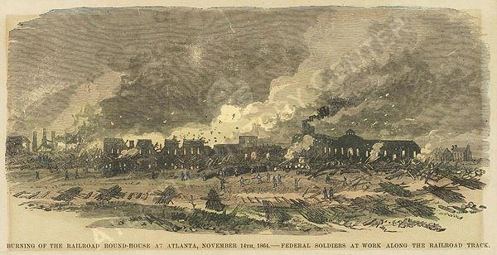
The End of the Civil War

Slide 2
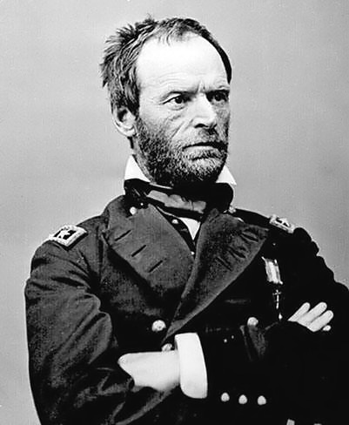
Last Stages of the Anaconda Plan
In the summer of 1864, the Union began to carry out the last stages of the Anaconda plan
Union General Sherman pushed Confederate troops out of the deep South with his scorched earth policy
General Grant made plans to take
Richmond, VA

Slide 3
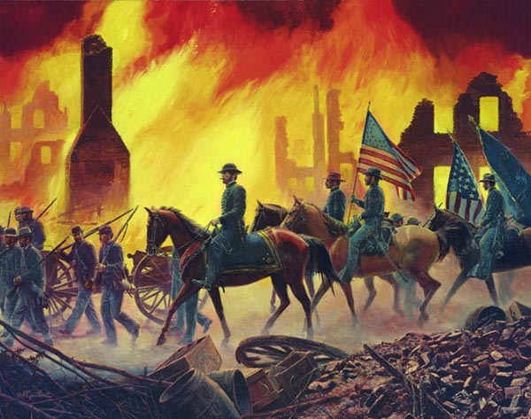
The Fall of Atlanta
The most devastating loss was Gen. Sherman’s capture of the biggest Confederate city, Atlanta, GA. which he ordered his troops to burn to the ground.
This victory helped Lincoln win re-election

Slide 4
Richmond, VA vs. Washington D.C.
In the spring of 1864, Union’s Grant and Confederate’s Lee fought fiercely, mostly in the 90 miles between these two capital cities
After a yearlong siege of Virginia, Grant captured and burned Confederate capital of Richmond, VA (March, 1865)
The Rebels had little chance of winning:
They were running out of food, weapons, ammunition, and medicine for the wounded

Slide 5
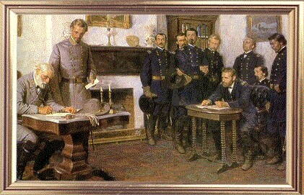
Appomattox Courthouse: THE END!
After Richmond, VA fell, Robert E. Lee and his soldiers fled to the mountains
The Confederates tried one last attack, but were unable to defeat the Union
On April 9, 1865, at Appomattox Courthouse in Virginia, General Lee surrendered to Ulysses Grant

Slide 6
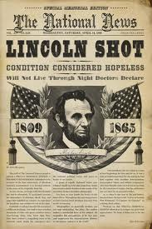
Lincoln Assassinated
During the war, there were many attempts on his life
On April 14th, while he was at a play, John Wilkes Booth successful shoots Lincoln
He dies on April 15th after fighting for his life overnight

Slide 7
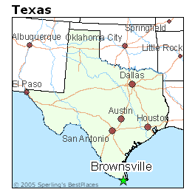
Last “Battle” of the Civil War
The last battle of the Civil War was fought at Palmito Ranch, Texas on May 12, 1865 (yes, after the war is over)
This was one month after Lee surrendered at Appomattox and the war ended
Confederates won!
…But it didn’t count

Slide 8
Lincoln Assassination Activity
Step 1: Read “Who Killed Lincoln?”
Step 2: Analyze 1 document and 1 photograph from the event by completing the analysis worksheet (front and back)
Step 3: Share findings about your document and photograph with your table
Step 4: Complete writing activity
1 | 2 | 3 | 4

