Slide 1
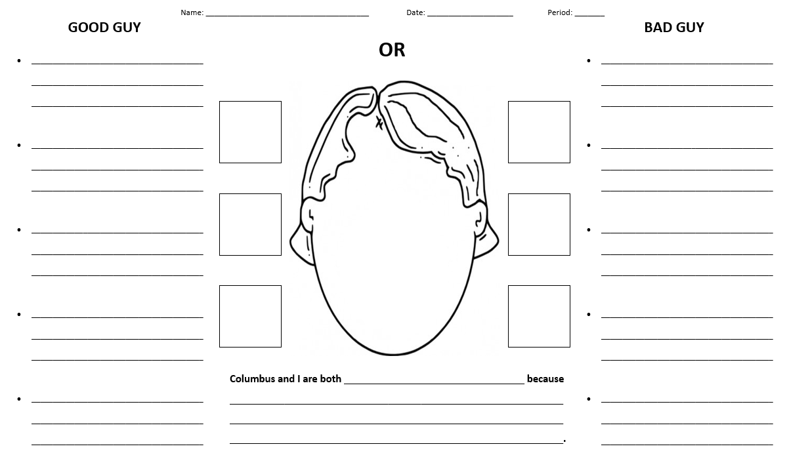
Positive Character Qualities Write a sentence for each of the five IBMYP learner profile characteristics that Columbus exhibited in his life.
Negative Character Deficits
Write a sentence for each of the five IBMYP learner profile characteristics that Columbus needed to develop in his life.
Draw/label 3 symbols of Columbus’s positive contributions to the world.
Draw/label 3 symbols of Columbus’s negative contributions to the world.
Add detail to Columbus’s head and face to show his positive and negative sides.
What positive character quality or qualities do you have in common with Christopher Columbus? Explain.

