Slide 1
Christopher Columbus
Good guy or bad guy?

Slide 2
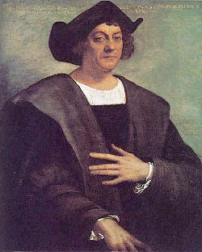
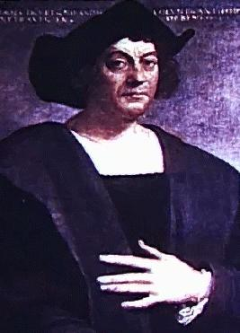
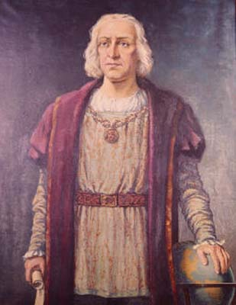
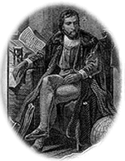
Columbus
No one know what Columbus looked like…no portraits were made in his lifetime…
Source of pictures: Library of Congress – 1492 Exhibit – accessed 6/04

Slide 3
Voyages of Christopher Columbus
“Columbus sailed the ocean blue in 1492.”
Or
“In 1493, Columbus stole all he could see.”

Slide 4
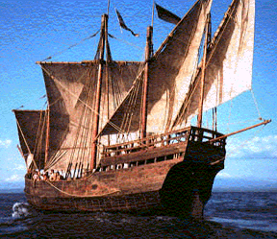
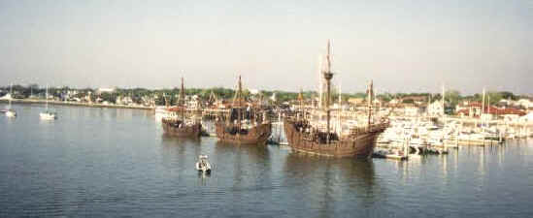
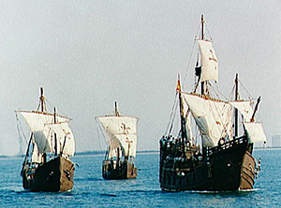
The Ships
Niña – 67 ft long, 21 ft. wide; 20 men
Pinta – 70 ft. long, 22 ft. wide; 26 men
Santa Maria – 77 ft. long, 26 ft. wide; 40 men
Source of pictures: Library of Congress – 1492 Exhibit – accessed 6/04

Slide 5
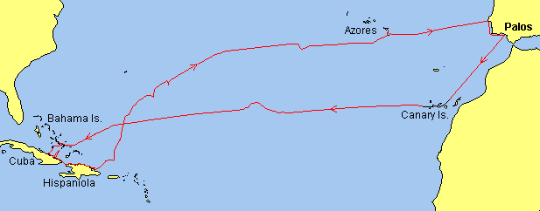
The 1st Voyage
Left Spain in August – after ship repairs left the Azores in September – sighted land on October 12, 1492 on a small island in the Bahamas – later explored Cuba and Hispaniola [present day Haiti and the Dominican Republic].
Source of map: Library of Congress – 1492 Exhibit – accessed 6/04

Slide 6
Columbus was Spanish
FALSE!
Columbus was Italian but married a Portuguese women and moved to Lisbon. The King & Queen of Portugal wouldn’t fund his voyage so he went to Spain.

Slide 7
Columbus was looking for God, Gold, & Glory
TRUE!
GOD = spread Christianity
GOLD = money
GLORY = fame

Slide 8
Columbus proved the world was round.
FALSE!
People had known the world was round for almost 2,500 years. Even Aristotle knew!

Slide 9
Columbus discovered America!
FALSE!
Columbus landed in the Bahamas.
The Native Americans lived in the Americas without the Europeans until around the 1500s. That’s almost 11,500 years before Columbus!
The Vikings explored North America long before Columbus.

Slide 10
Columbus named Indians
TRUE!
Columbus was looking for a new route to India.
He thought he had arrived in India and so he called the natives Indians.

Slide 11
Columbus brought death & destruction.
TRUE!
Columbus and his men brought diseases that Native Americans’ bodies were not used to and ended up wiped out many of the Native Americans.

Slide 12
Columbus made Indians slaves.
TRUE!
Columbus captured Native Americans and used them for labor in the New World or sent them to Spain as slaves. If they died on the voyage over, their bodies were dumped over the sides of the boat.

Slide 13
Columbus = Age of Exploration & Discovery
TRUE!
Columbus was one of the first Europeans to explore the New World. After his voyages many more, Europeans came including those who “discovered” Texas. Without his voyages, who knows?

Slide 14
Columbus = Respect
FALSE!
Columbus thought the natives were savages and some of his men even killed and tortured Native Americans while in the New World.

Slide 15
NA gave Columbus gold
FALSE!
Columbus stole gold from the Native Americans. He did not find much but he did whatever he could to get it.

Slide 16
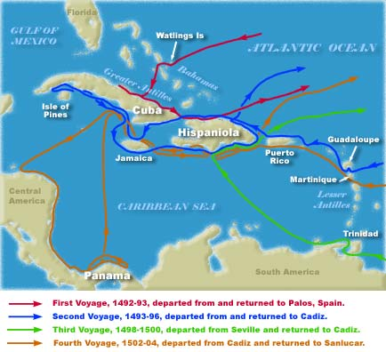
Columbus made four voyages to the New World between 1492 - 1504
Source of pictures: Library of Congress – 1492 Exhibit – accessed 6/04

Slide 17
