Slide 1
Warm-up
1. During the 19th century, what was a difference between the North and the South?
  Ideas about slavery
  Economic systems
  Political beliefs
  All of the above

Slide 2
“The Union is older than any of the States, and, in fact, it created them as States. Originally some dependent colonies made the Union, and, in turn, the Union threw off their old dependence for them, and made them States, such as they are. Not one of them ever had a State constitution independent of the Union. Of course, it is not forgotten that all the new States framed their constitutions before they entered the Union — nevertheless, dependent upon and preparatory to coming into the Union.”
2. What can you infer about the speaker of this quote?
  He was a Northerner and an advocate of states’ rights
  He was a Southerner and an advocate of states’ rights
  He was a Northerner and an advocate of a strong federal government
  He was a Southerner and an advocate of a strong federal government
Notes:
Abraham Lincoln - Message To Congress In Special Session (1861)

Slide 3
Antebellum America
1820-1860

Slide 4
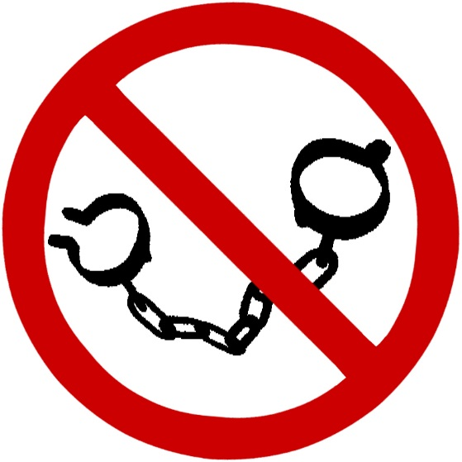
Ante-bellum, anti-slavery
Antebellum – literally “before the war”; commonly refers to the time period before the American Civil War during which slavery became a major issue
Abolitionist – a person who works to end slavery

Slide 5
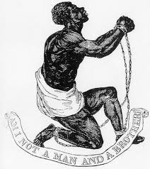
Life as a Slave
Many worked on farms and plantations in the South.
A slave could have many jobs such as…
  Planting and tending crops
  Picking, processing, and loading cotton
  Constructing and repairing buildings and fences
  Hauling water
  Clearing land
Living and working conditions were often extremely harsh led by strict “masters” (slave owners) and slave drivers.
Slaves were often deprived of an appropriate education, like how to read and write.

Slide 6
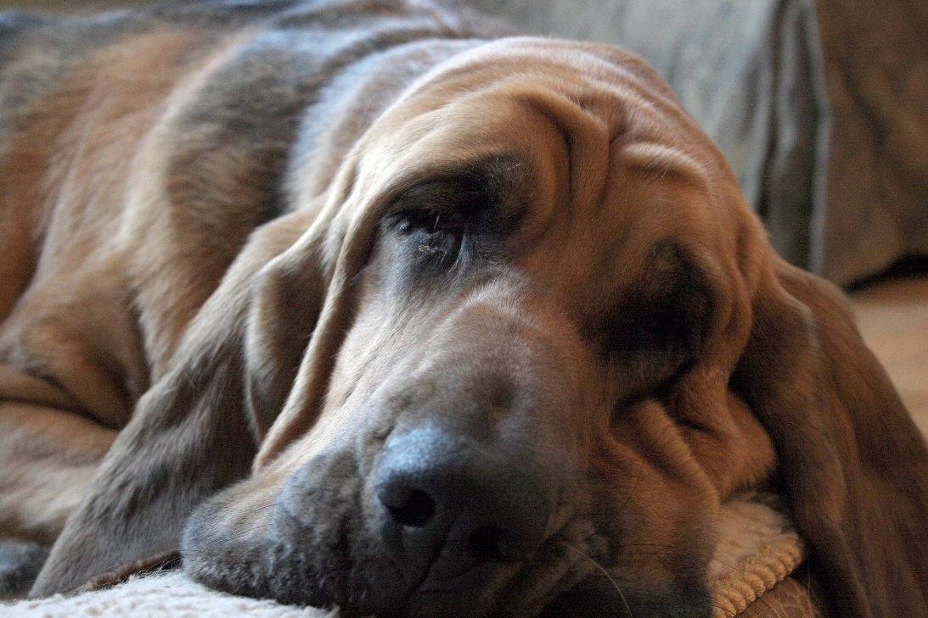
Fugitive Slave Act (1850)
The Fugitive Slave Act (from the Compromise of 1850) required that all escaped slaves were, upon capture, to be returned to their masters.
All officials and citizens of the United States, including those in free states, had to cooperate with this law.
Bloodhounds (a type of dog) were even used to track down runaway slaves.

Slide 7
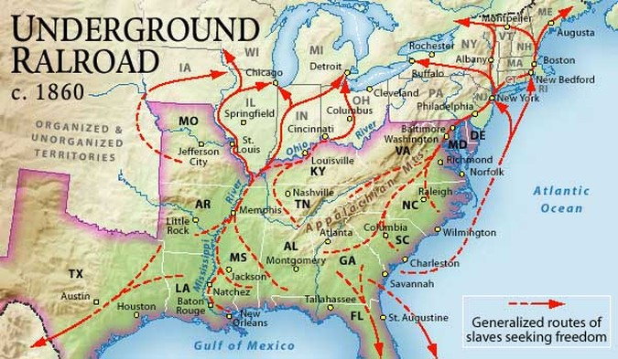
The Underground Railroad
Even after the passage of the Fugitive Slave Act, many abolitionists still wanted to work to end slavery and help slaves escape to their freedom.
The Underground Railroad was a network of safe houses where runaway slaves could safely stay on their way North or out of the United States.
Notes:
“Passengers” traveled at night
Rested at “stations” (Barns, basements, and attics)
The railroad’s “conductors” were whites and African Americans who helped the runaways to freedom in Northern States and Canada
American Colonization Society and Liberia

Slide 8
Abolitionist Movements
Abolitionists had both peaceful and violent approaches to ending slavery.
  Literature, speeches, newspapers, peaceful assembly
  Violent protests, raids, killings
However, only a small percentage of freed slaves and Northerners were abolitionists.
Many Northerners saw the anti-slavery movement leading to:
  Loss of their jobs to freed slaves who would work for less $$
  Disruption of the social order (still discrimination in North)
  Further division of the North and South to the point of war
Notes:
Talk about South still defending slavery – necessary for agriculture and said they treated them well

Slide 9
Notes:
Introduce tea party – ask what they notice about the people in these pictures

