Slide 1
Warm-up:
What is the best conclusion that can be drawn from the excerpt below?
“I am perfectly aware of the difficulties that surround me…Had it been my destiny, I would infinitely have preferred the toils, privations, and perils of a soldier, to the duties of my present station.”
– Sam Houston, 1838 Inaugural Address
Texans wanted to continue the fight for independence.
Houston was uncertain about the future of Texas as a Republic.
Houston was willing to continuing fighting until the death.
Texans did not want to be a country – they wanted to be a state in the United States.

Slide 2
Warm-up:
What is the relationship between Sam Houston and Mirabeau Lamar?
Agreed on all Republic policies
Leaders of the TX Rangers
Had differing views on Republic policies
Served multiple terms as President
What are the possible outcomes of annexation to the United States?
War with Mexico
Assumption of Debts
Increased Trade with other countries
All of the above

Slide 3
Warm-up:
Which statement best supports the idea of sectionalism?
Cotton is the most important resource in the United States, the North would perish without it.
The spreading of Americans to the West was inevitable.
The power of the United States lies in their unity.
Presidents are elected by the country, not by individual states.

Slide 4
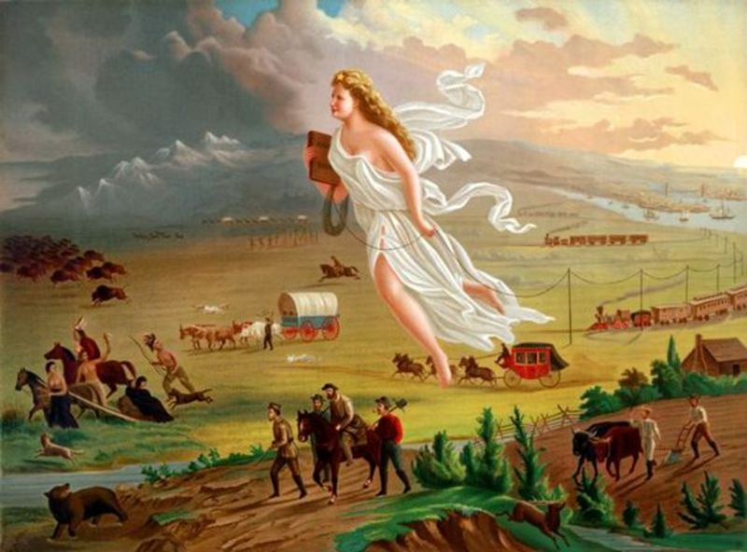
American Progress – John Gast (1872)
History Scene Investigation

Slide 10
New Vocabulary
Manifest Destiny – the 19th-century belief that the expansion of the U.S. throughout the American continents was justified, inevitable, and God’s will (idea)
Westward Expansion – the acquiring of land that ultimately lead to the growth of the United States (action/time period)
Imperialism – extending your country’s power by any means necessary

Slide 11
Reasons for Manifest Destiny
Term first coined by John L. O’Sullivan in Democratic Review, July 1845
Reasons for this belief:
Sincere belief in democracy
Americans viewed the U.S. as a model for other nations
The idea of Manifest Destiny was aligned with racist and imperialistic [extending your country’s power] ideas towards Native Americans and Mexicans
Tied to religion – “God wants our nation to Grow”
Less separation of church and state (government) during this time period

Slide 12
Population Growth
As the United States grew, so did the population
In Texas, new/growing groups included…
Tejanos: South Texas
European immigrants (German, Czech, Irish, etc.): Central Texas
American farmers from the South who brought slaves: East Texas
Why did settlers avoid moving to West Texas?

